Slide 1




(21CC505PC) SOFTWARE ENGINEERING
UPPAL CAMPUS
NARAYANGUDA
IBRAHIMPATNAM
LAB EXERCISE - 1
SRS DOCUMENT
TOPIC -1
INSTALLATION OF STARUML, GIT BASH AND
GITHUB ACCOUNT CREATION

Slide 2
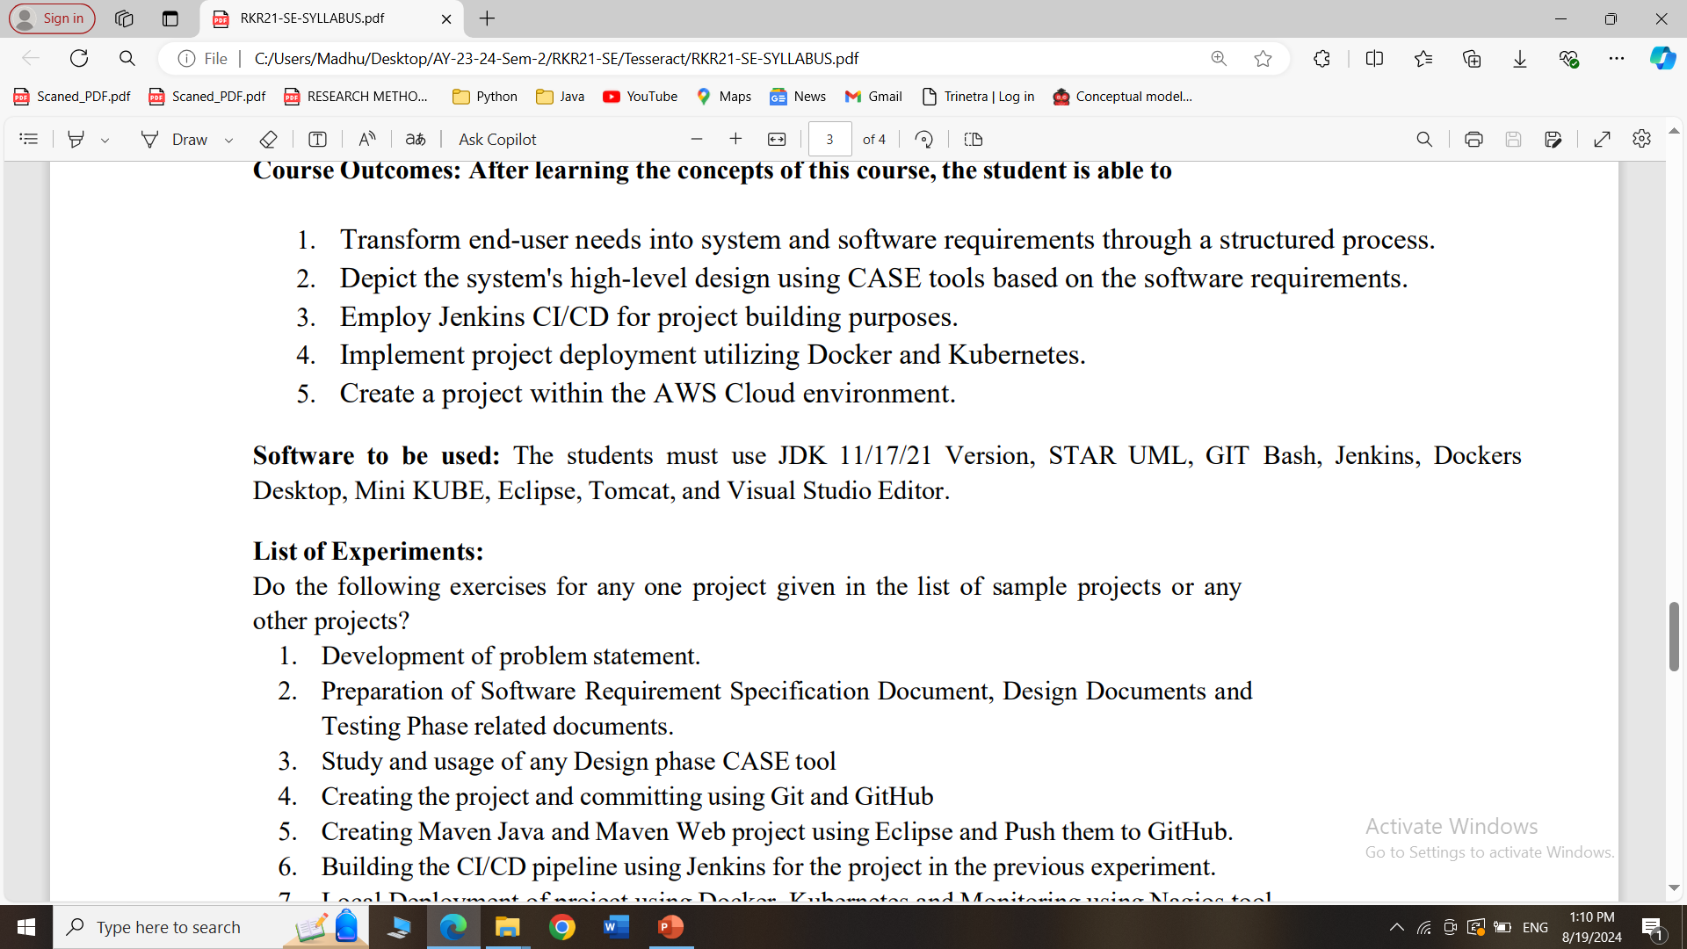
SYLLABUS

Slide 3
What is the use of STARUML?
StarUML is a software tool used to create diagrams that help in designing and understanding complex systems, especially in software development.
It allows you to visually map out how different parts of a system or application will work together, making it easier to plan, communicate, and build the system effectively.
Think of it as a drawing tool for software engineers to sketch out their ideas.

Slide 4
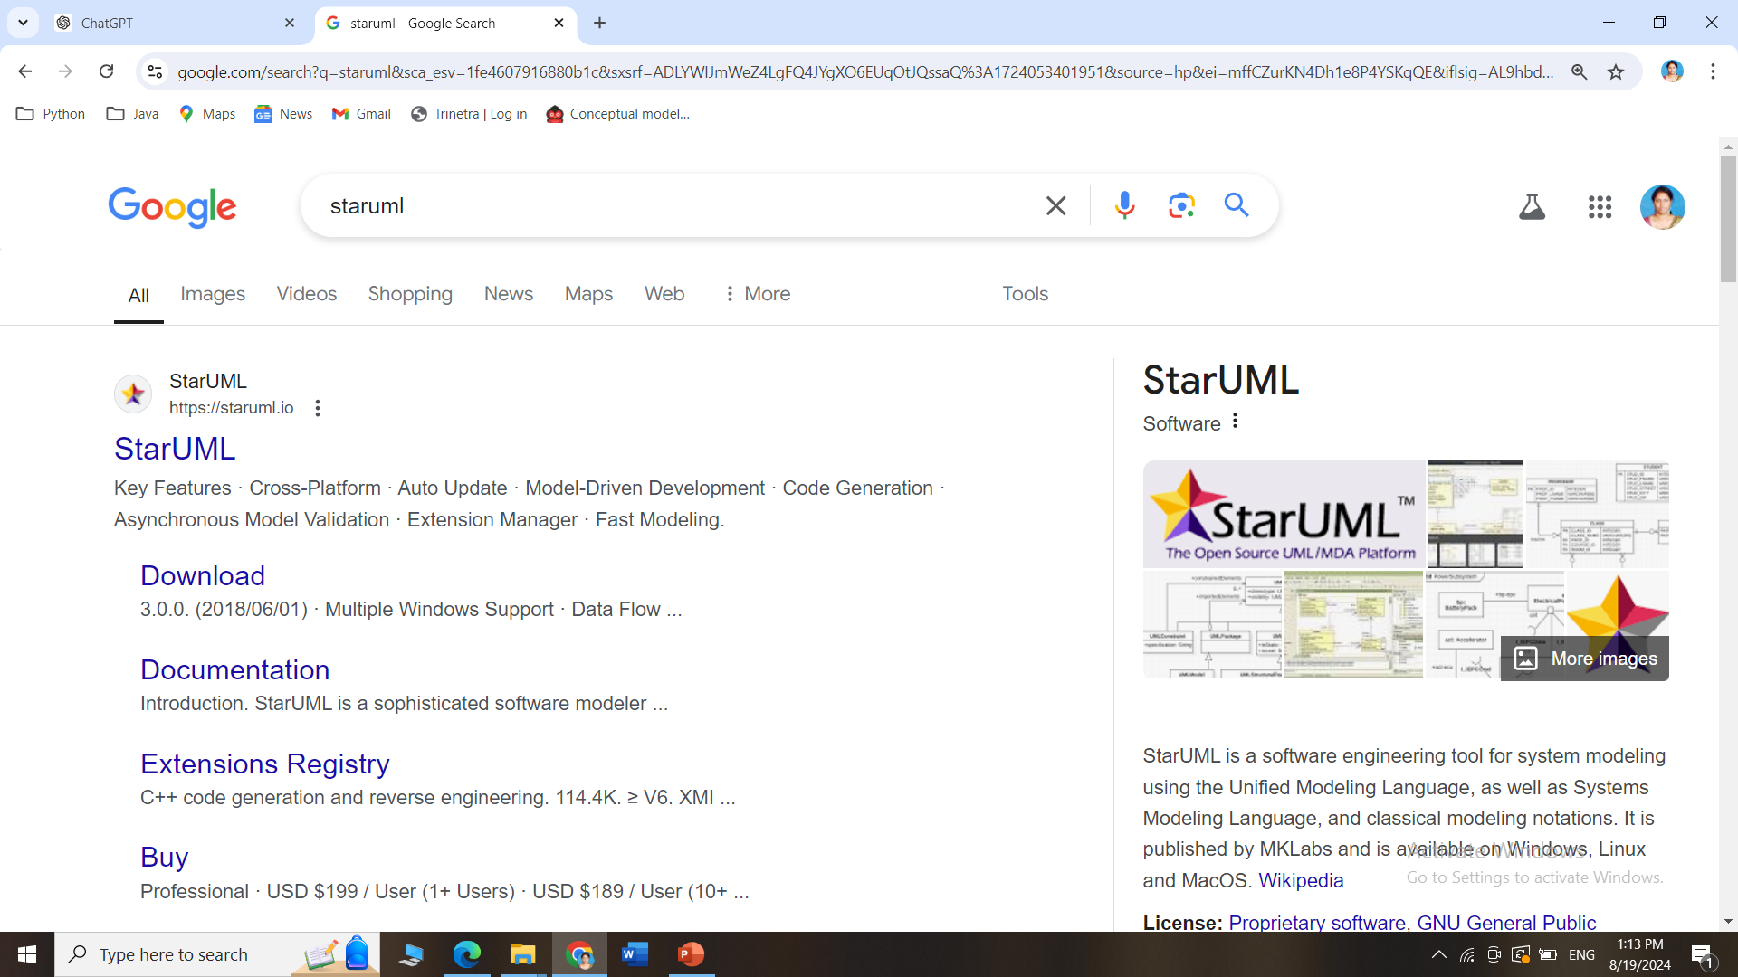
How to install STARUML
Search for StarUML in Google and Click on the official link

Slide 5
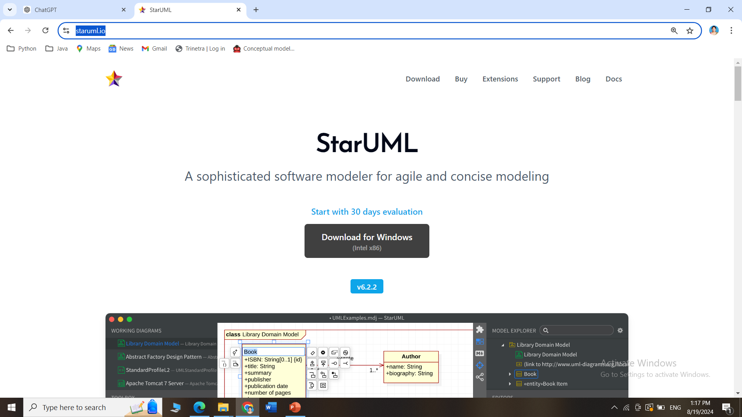
How to install STARUML
Go this site https://staruml.io/ and download StarUML for Windows/Mac

Slide 6
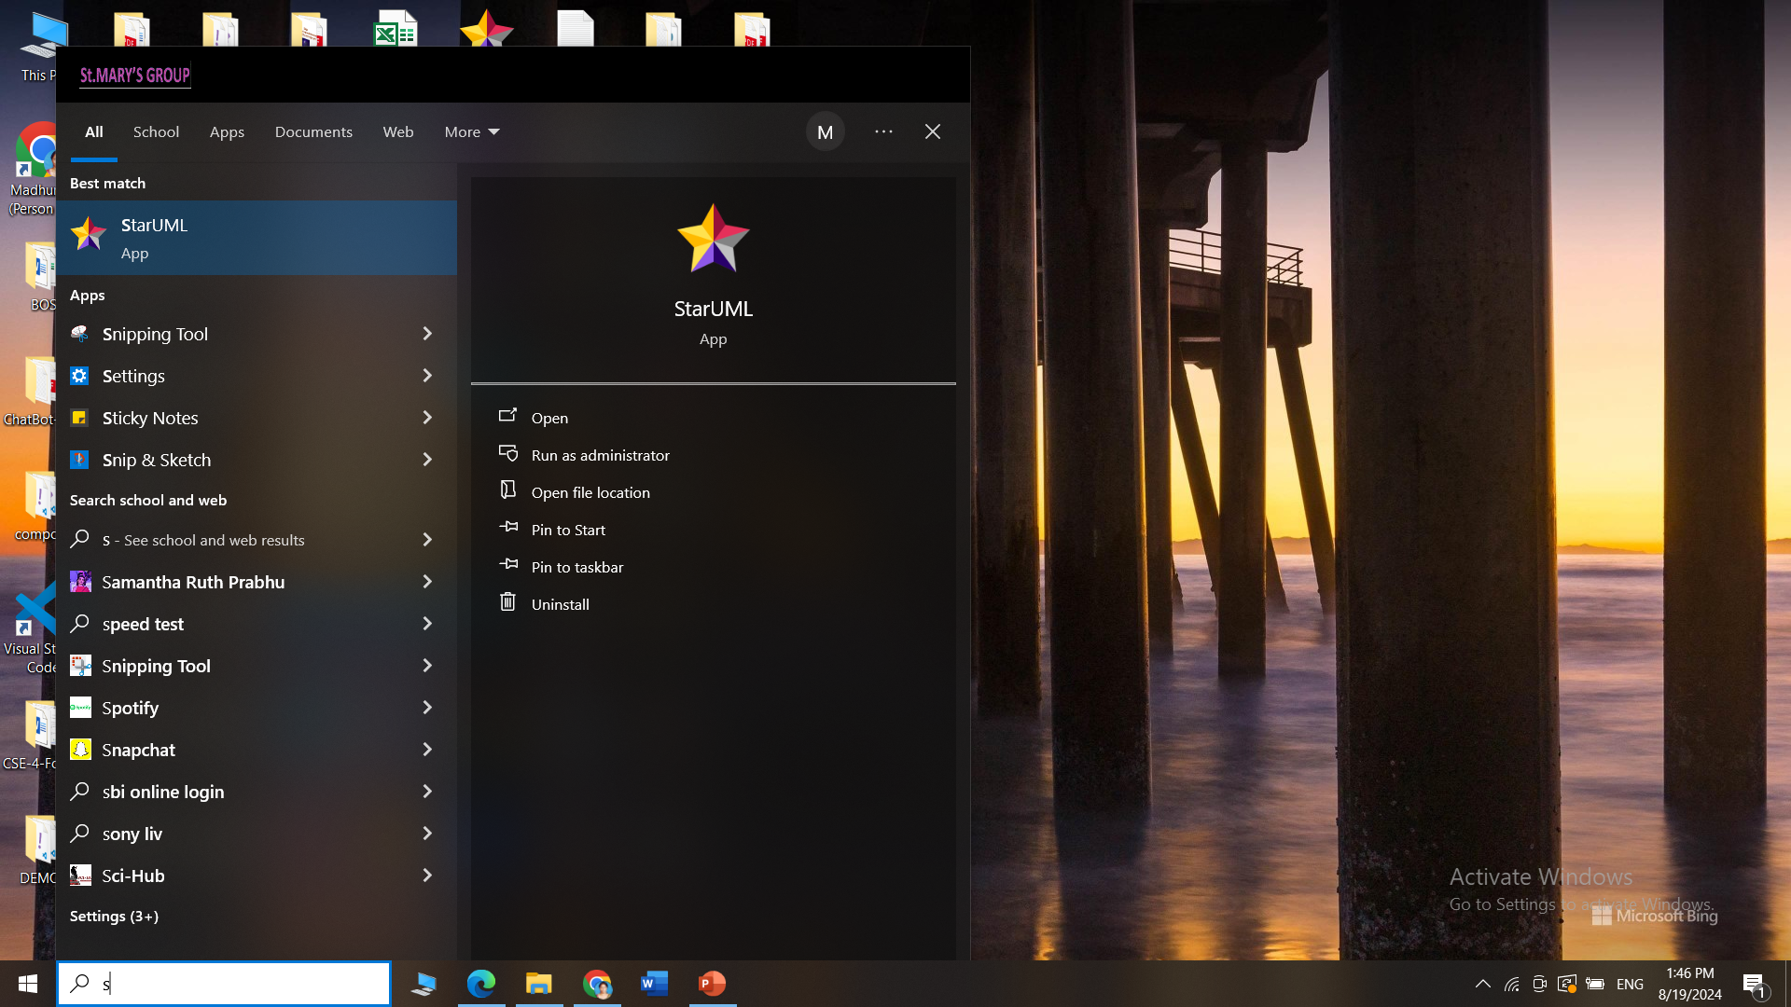
How to install STARUML
StarUML interface after installation

Slide 7
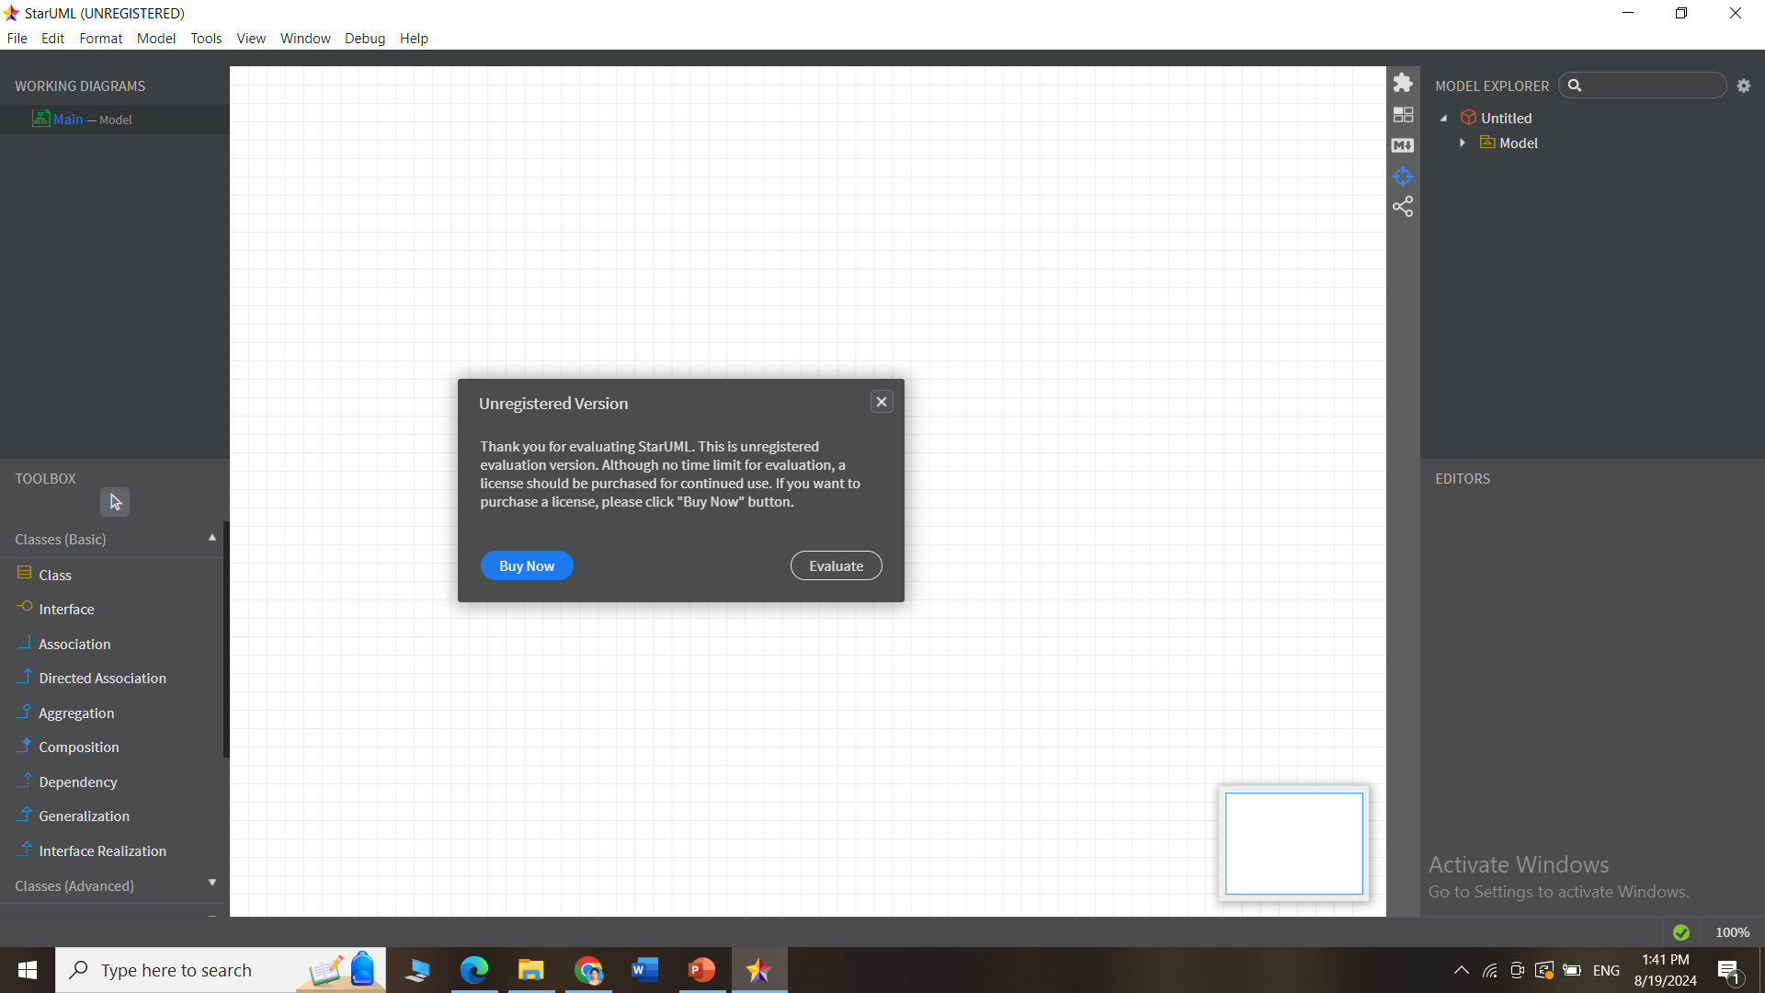
How to install STARUML
StarUML interface after installation

Slide 8
What is the use of GITBASH?
Git Bash is an application that lets you use Git commands on your computer.
Git: A tool for tracking changes in files, mainly used for managing code in software projects.
Bash: A command-line tool that allows you to type in commands to perform various tasks on your computer.
Purpose:
Git Bash combines Git and Bash, so you can easily manage your code and use commands to work with files and projects. It’s like a smart helper for keeping track of changes and collaborating with others on coding projects.

Slide 9
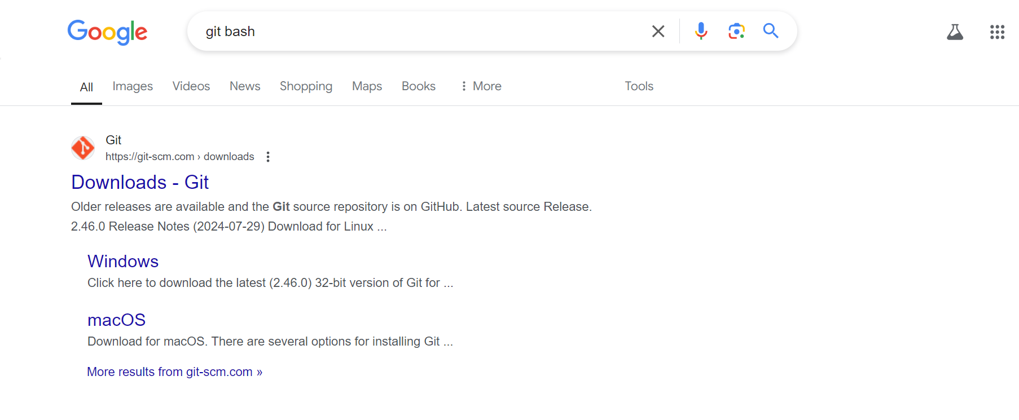
How to install Git
Search for git bash in Google and Click on the official link

Slide 10
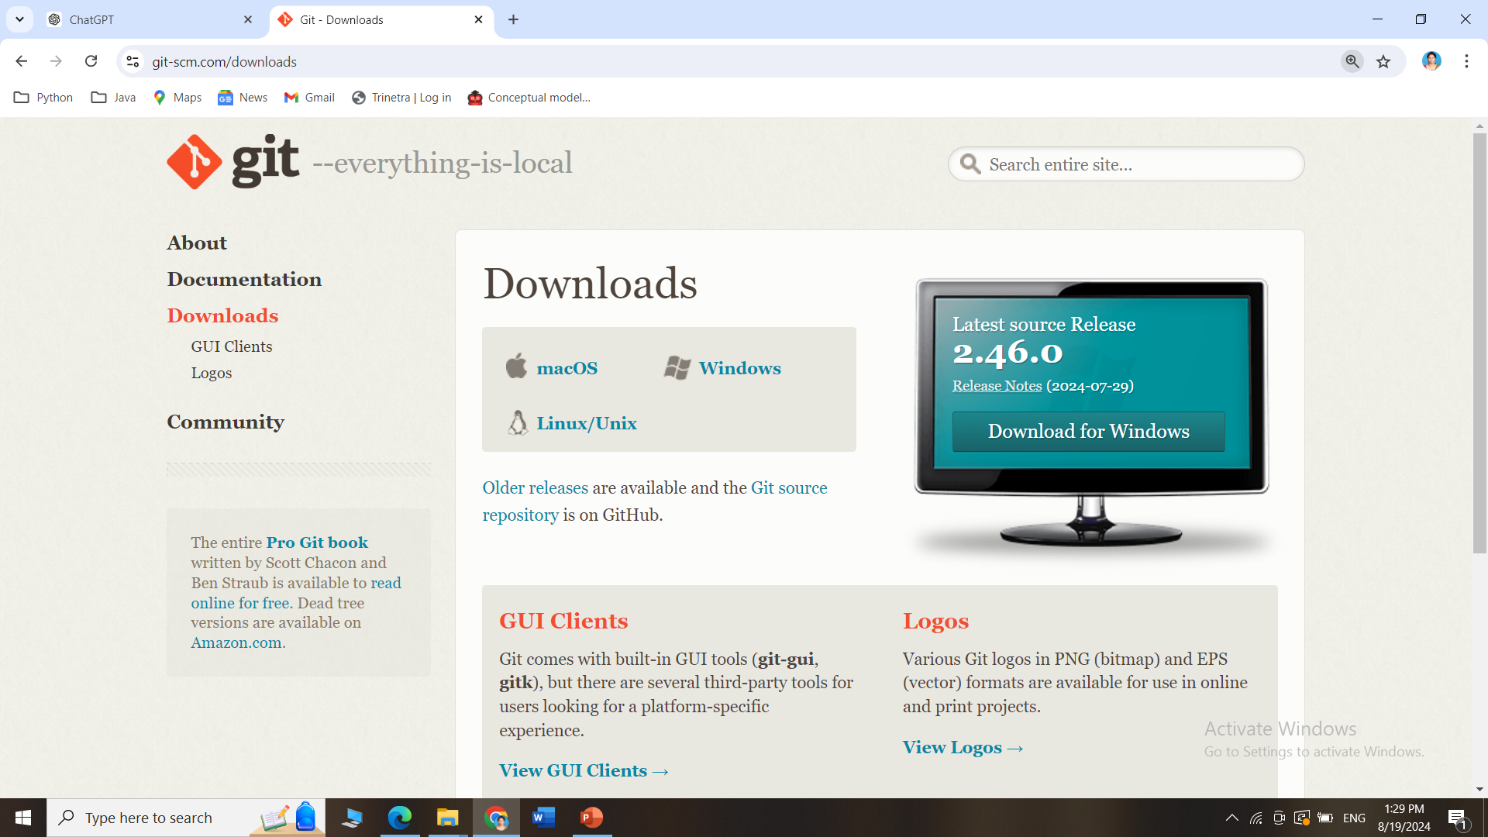
How to install GitBash
Go this site https://git-scm.com/downloads and download Git for Windows/Mac

Slide 11
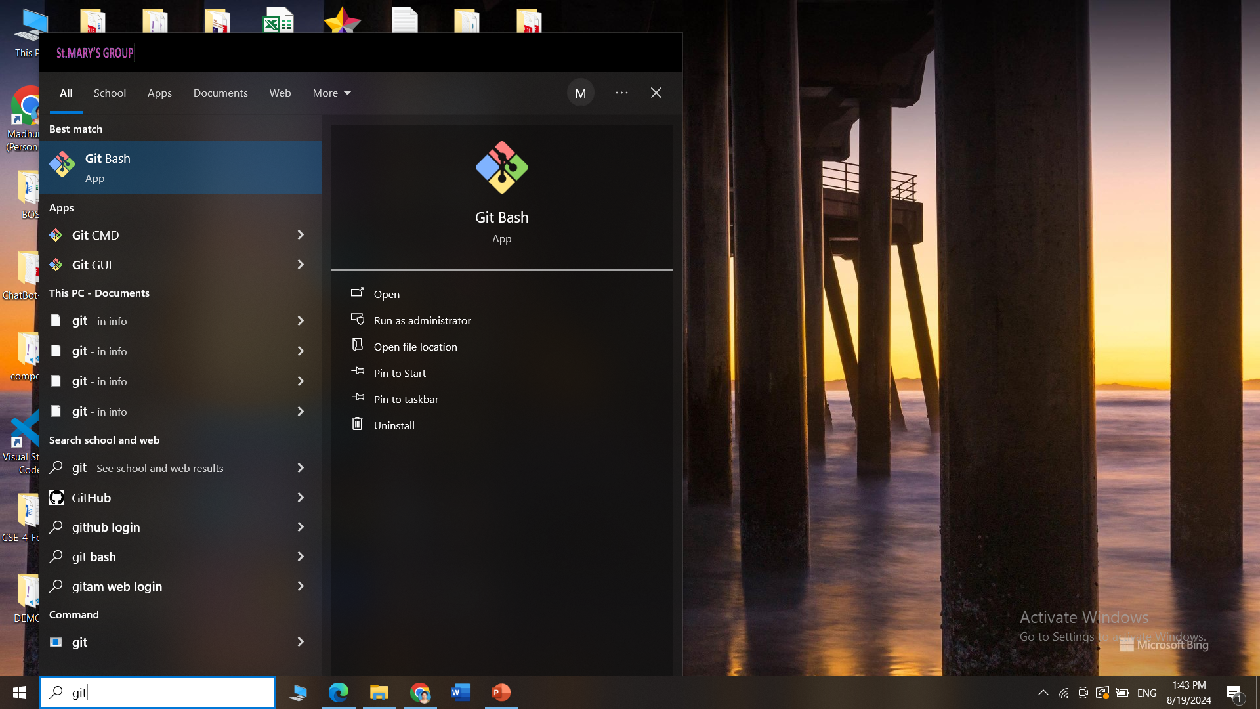
How to install Git
GitBash interface after installation

Slide 12
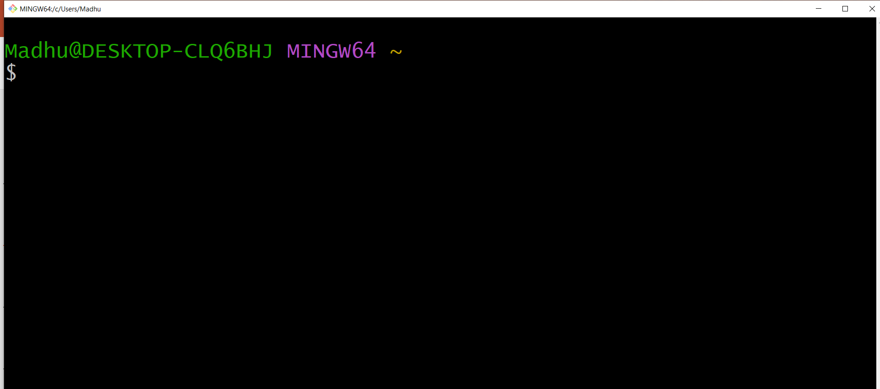
How to install Git
GitBash interface after installation

Slide 13
What is the use of GitHub?
GitHub is a website where people can store and share their computer code.
It's like a big, online folder where you can keep your work, make changes, and collaborate with others.
Think of it as a place where you and your team can work on a project together, track changes, and keep everything organized.

Slide 14
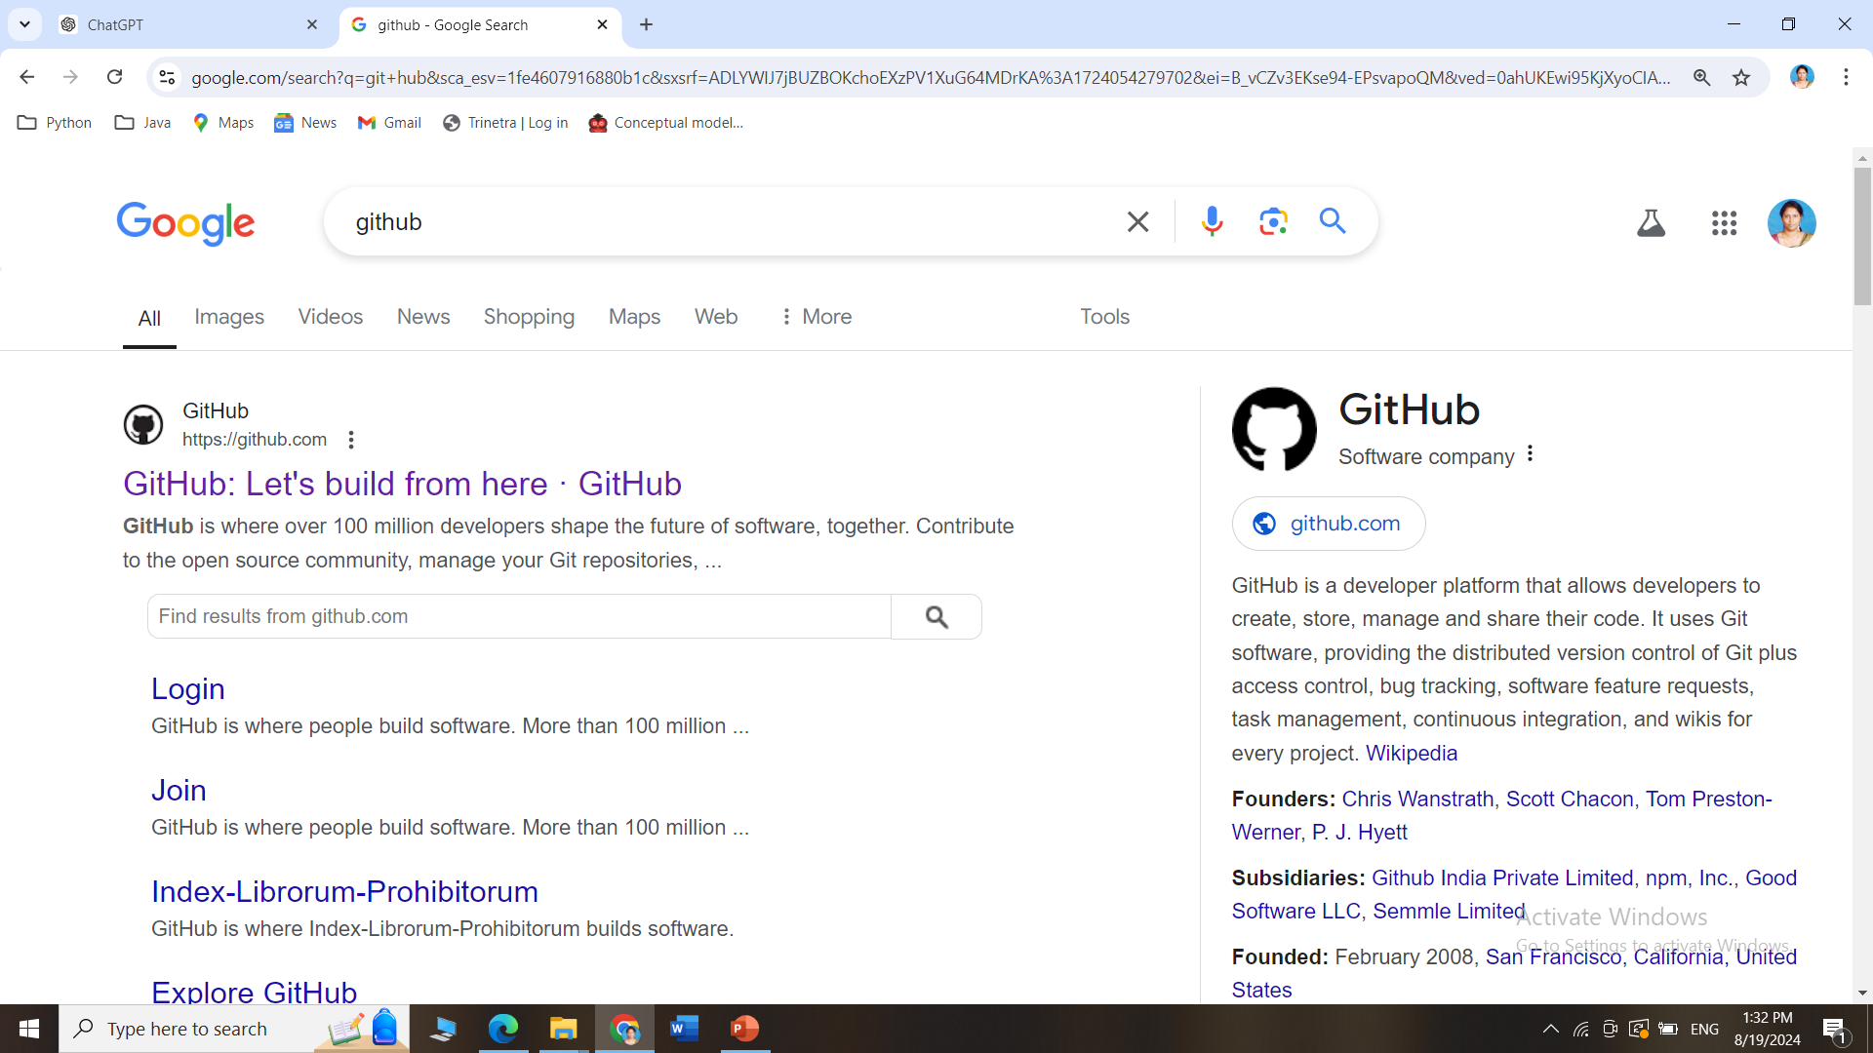
How to create an account in GitHub?
Search for github in Google and Click on the official link

Slide 15
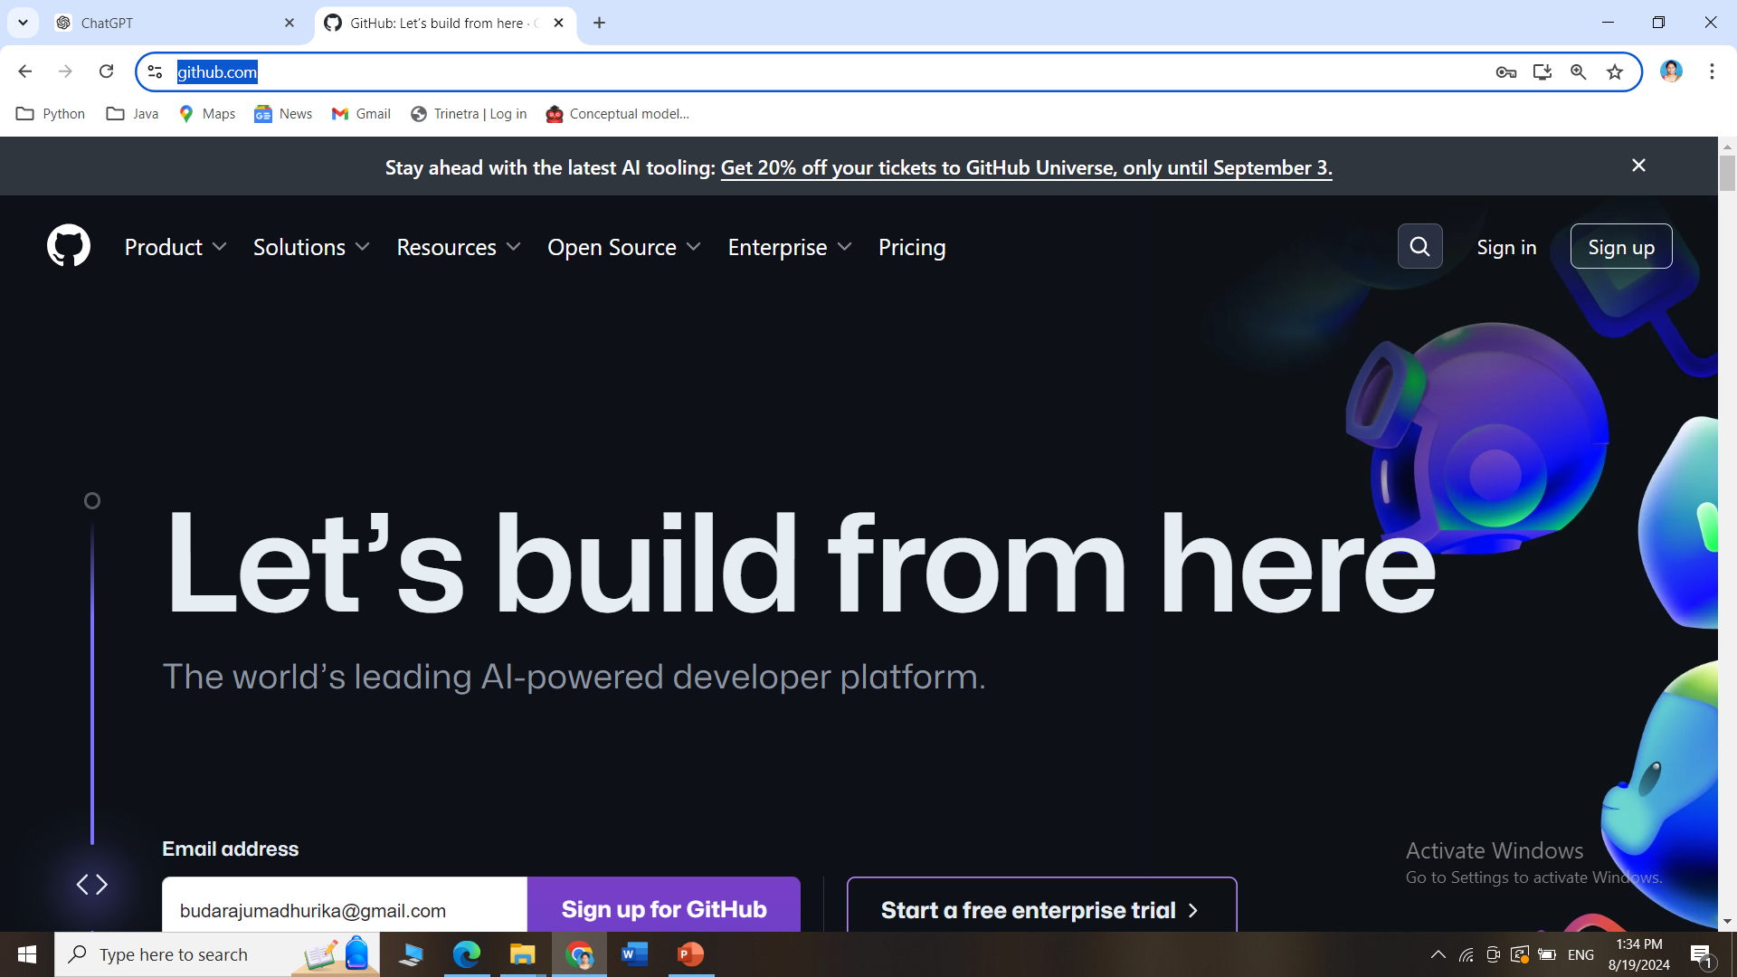
How to create an account in GitHub?
Go this site https://github.com/ and click on Sign Up

Slide 16
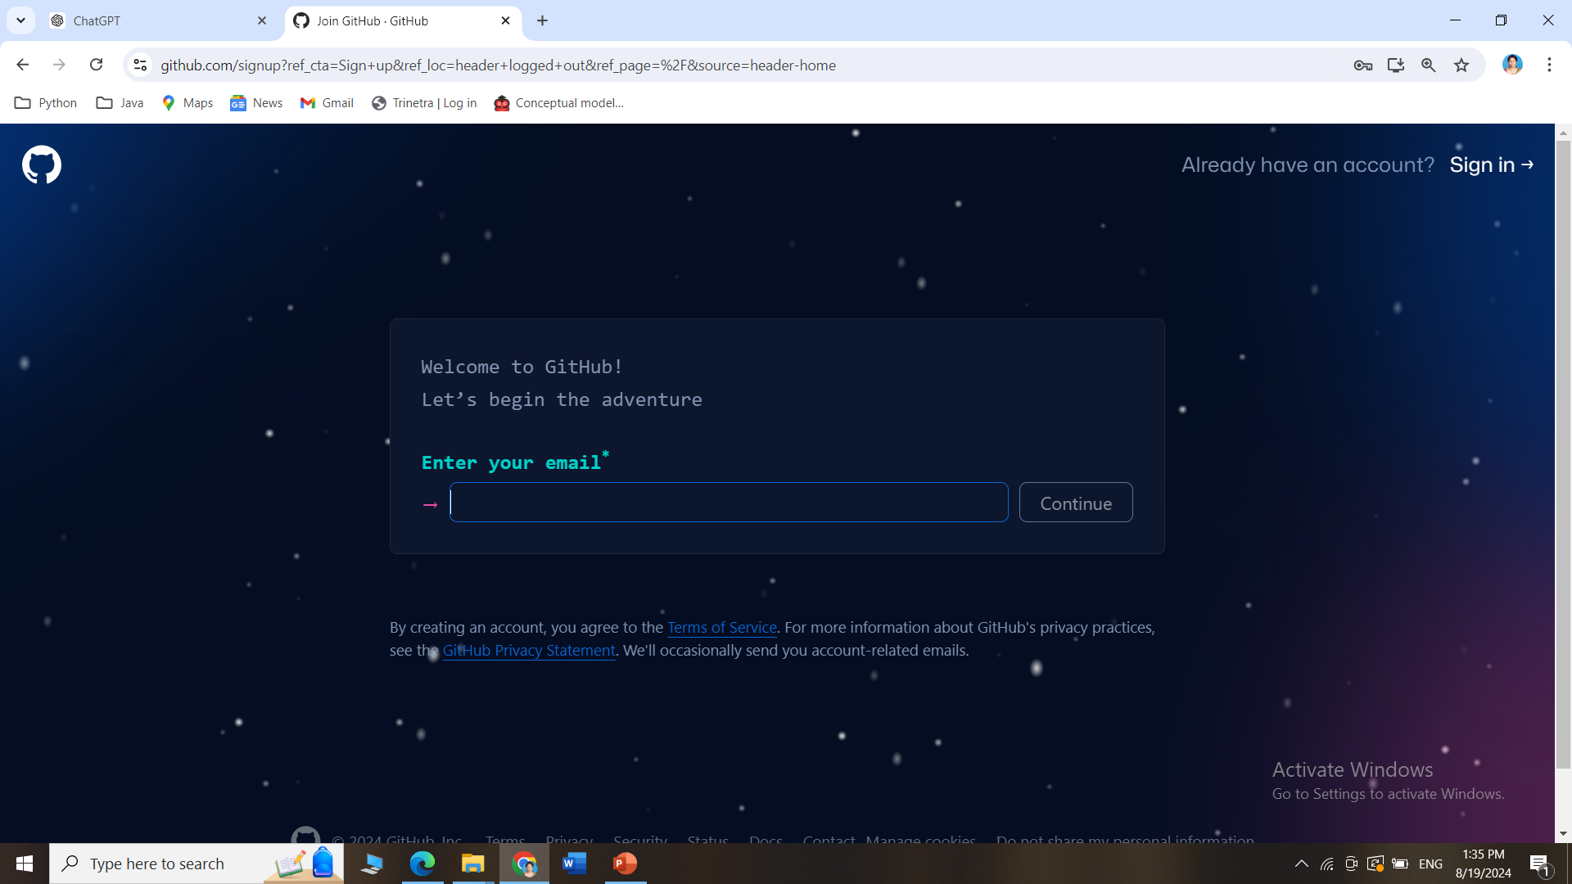
How to create an account in GitHub?
Follow the steps of Signup to create an account in GitHub

Slide 17
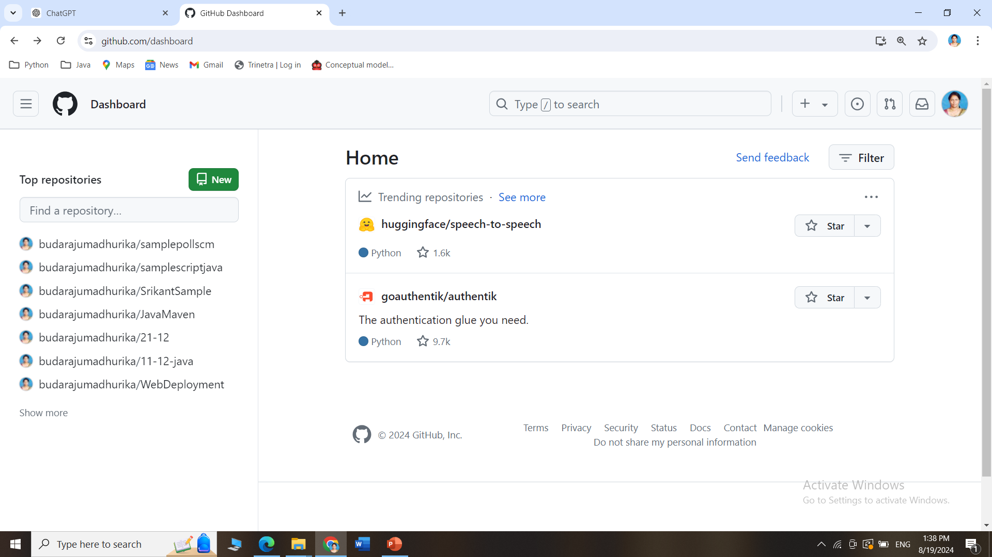
How to create an account in GitHub?
The GitHub dashboard after account creation

Slide 18
(21CC505PC) SOFTWARE ENGINEERING
UPPAL CAMPUS
NARAYANGUDA
IBRAHIMPATNAM
LAB EXERCISE - 1
SRS DOCUMENT
TOPIC -2
IEEE – SRS (SOFTWARE REQUIREMENTS SPECIFICATION)

Slide 19
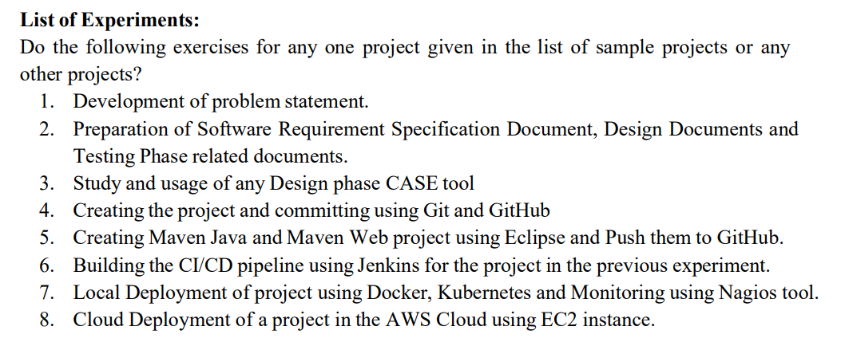
SYLLABUS

Slide 20
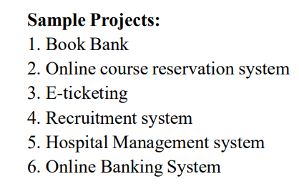
SYLLABUS

Slide 21
What is an SRS Document?
SRS stands for Software Requirements Specification.
It is a detailed document that describes what a software product is supposed to do.
Think of it as a blueprint for software development, much like an architect's plan for a building.

Slide 22
Why is an SRS Document Needed?
Clarity and Understanding
Guides Development
Communication Tool
Manages Changes
Helps in Testing

Slide 23
IEEE - SRS
IEEE SRS stands for Software Requirements Specification as defined by the Institute of Electrical and Electronics Engineers (IEEE).
It is a standardized format for writing an SRS document, ensuring that all important aspects are covered.
IEEE-SRS-Template

Slide 24
IEEE - SRS
Example document:
Sample_SRS-Document

Slide 25
(21CC505PC) SOFTWARE ENGINEERING LAB
UPPAL CAMPUS
NARAYANGUDA
IBRAHIMPATNAM
LAB EXERCISE - 3
CASE TOOL
TOPIC -1
CONCEPTUAL MODEL OF UML

Slide 26
SYLLABUS

Slide 27
What is UML?
UML, or Unified Modeling Language, is like a set of blueprints for designing software.
It helps people understand how a software system works by using simple pictures (called diagrams) to show different parts of the system and how they connect.
Imagine you want to build a house – you’d use a blueprint to plan where the rooms, doors, and windows go.
UML does the same thing for software, helping developers and others visualize and plan how the software is built and how it will work before they start coding.

Slide 28
Case Tools
Commonly used CASE (Computer-Aided Software Engineering) tools for designing software projects:
Rational Rose
Enterprise Architect
Microsoft Visio
Lucidchart
ArgoUML
Visual Paradigm
SmartDraw
StarUML
Balsamiq
Creately
Umbrella

Slide 29
Conceptual Model of UML
The conceptual model of UML is about how we think of a system using diagrams. It has three main parts:
Things/Objects: These are the things in a system, like people, data, or actions.
Relationships: These show how objects connect and interact with each other.
Diagrams: These are the pictures we use to represent the objects and their relationships. Each type of diagram shows a different view, like how parts work together or how things change over time.

Slide 30
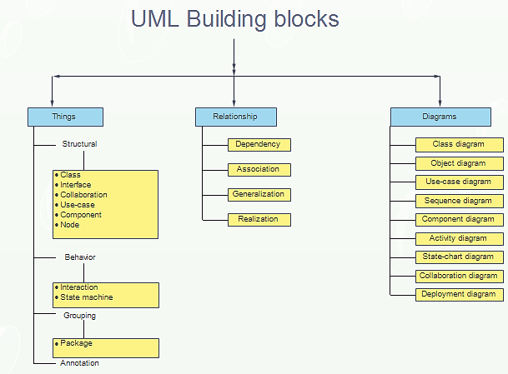
Conceptual Model of UML

Slide 31
Things in UML
These are the main elements that exist in a system, such as objects, components, or behaviors.
"Things" are categorized into:
Structural Things
Behavioral Things
Grouping Things
Annotational Things

Slide 32
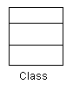
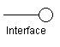
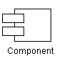
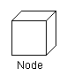
Structural Things (Static parts of the system)
These represent the static aspects of a system. They describe what things are made of.
Class: Defines objects with common features.
Example: A “Car” class has features like color, make, model.
Interface: Lists methods for classes to use.
Example: A “Drivable” interface ensures the Car class has a “drive” method.
Component: A piece of the system.
Example: A “Payment” component handles all payment processing.
Node: Picture a computer that runs an app. This computer (or server) is a "Node" where the software is working.
Example, a "Database Server" node stores all the app's information.

Slide 33
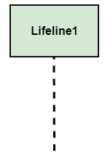
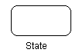
Behavioral Things (How the system acts)
These represent the dynamic aspects of a system. They show how the system behaves and changes over time.
Interaction: Shows messages exchanged between parts.
Example: A customer asks for products; the system responds.
State Machine: Represents different stages an object can be in.
Example: A door can be “Open” or “Closed”.

Slide 34
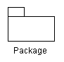
Grouping Things
These help organize and group various elements in a system.
Package: Groups related elements (like classes or interfaces) into a logical collection.
Example: A "User Management" package can contain classes for users, roles, and permissions.

Slide 35

Annotational Things
These provide additional information or notes. Extra notes or comments on the design.
Annotation: Comments or constraints that provide further explanation. Example: A comment on a class diagram explaining why a certain method is important.

Slide 36
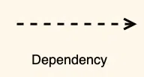
Relationships in UML
These define how different "things" are connected or interact with each other.
Dependency: One element depends on another.
Symbol:
Example: A "Car" class depends on an "Engine" class to function.

Slide 37
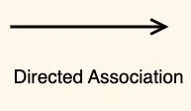
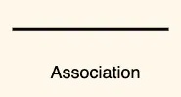
Relationships in UML
Association: A general connection between two things (often called objects or classes)..
Example: A teacher teaches a student, and a student learns from a teacher.
Symbol:
An "Order" depends on a "Product" to exist because an order is placed for products.
A "Doctor" can treat many "Patients," and a "Patient" can see many different "Doctors." Both have a connection (doctor-patient relationship), but they can exist separately.

Slide 38
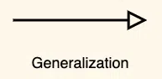
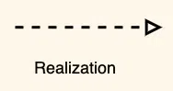
Relationships in UML
Generalization: This represents inheritance. One element is a more general version of another.
Example: A "Car" class is a generalized version of a "Sedan" or "SUV" class. The Sedan and SUV inherit attributes from the Car.
Symbol:
Realization: A class implements the behavior defined by an interface.
Example: Imagine there is a "Flyable" interface that says every class using it must have a method called "fly." The "Bird" class would realize the "Flyable" interface by implementing the "fly" method.

Slide 39
Diagrams in UML
Types of Diagrams in UML:
Class Diagram
Object Diagram
Use-case Diagram
Sequence Diagram
Component Diagram
Activity Diagram
State-chart Diagram
Collaboration Diagram
Deployment Diagram

Slide 40
Diagrams in UML
Class Diagram: Shows types of things in the system, and how they relate.
Example: An "ATM" class connected to a "Card" class that handles money requests.
2. Object Diagram: A snapshot of real items, like a specific "Debit Card," at one moment.
Example: A "Debit Card" showing details for one user.
3. Use-case Diagram: Shows how people use the system, like withdrawing cash or checking balance.
Example: A user withdrawing cash or checking their balance.

Slide 41
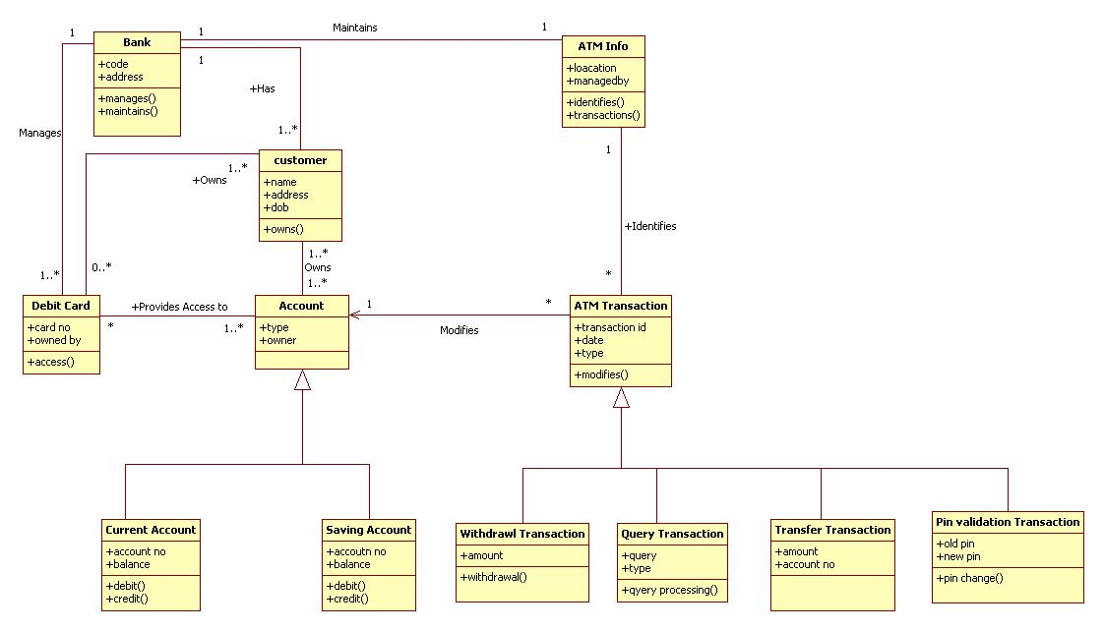
Class Diagram in UML

Slide 42
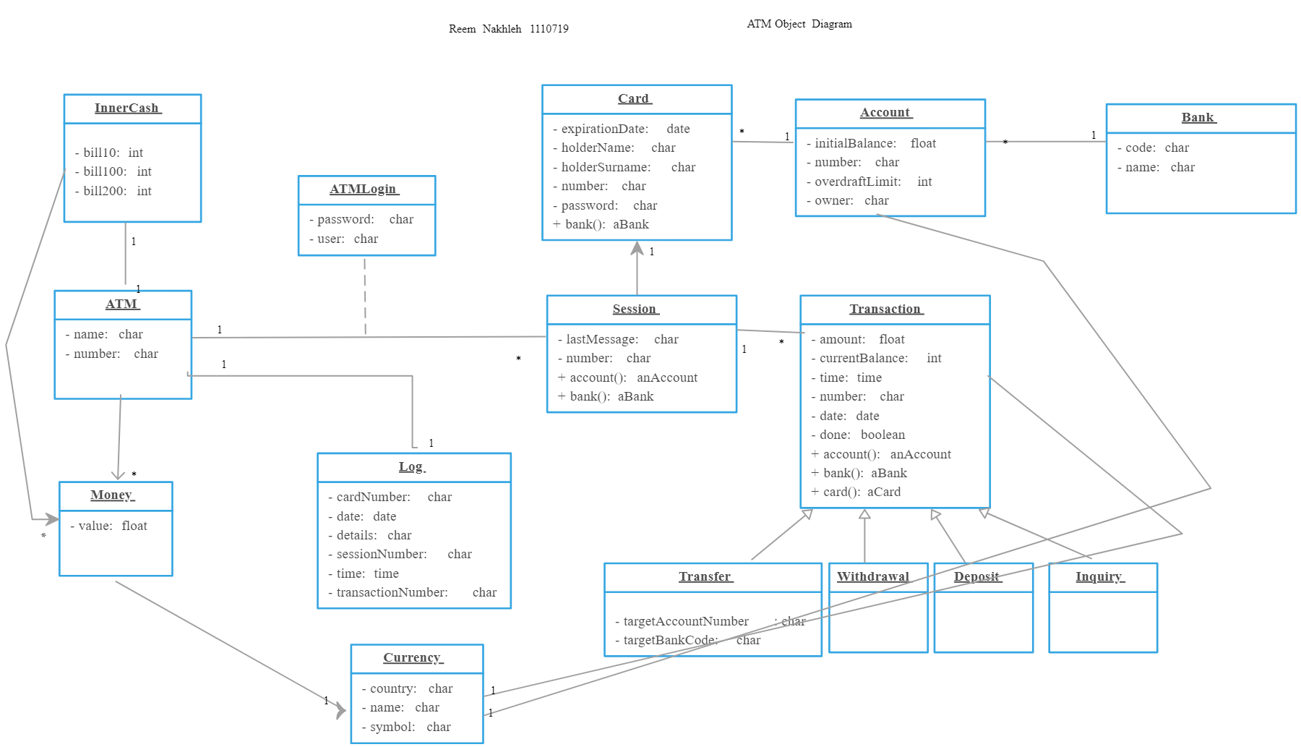
Object Diagram in UML

Slide 43
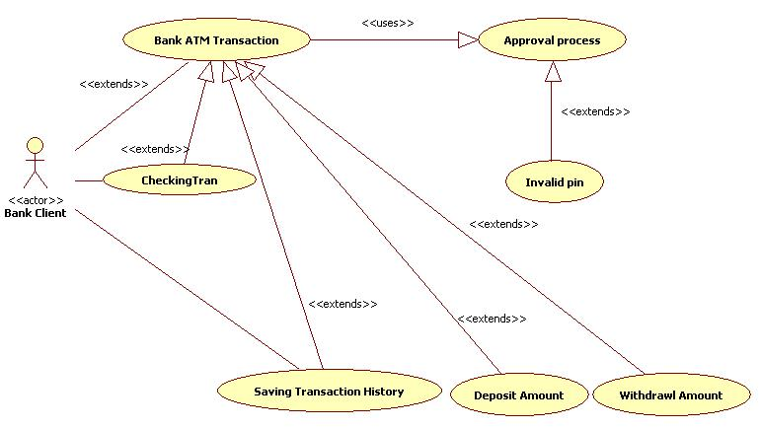
Usecase Diagram in UML

Slide 44
Diagrams in UML
4. Sequence Diagram: Shows how different things talk to each other step by step
Example: A user requests cash, the machine talks to the bank, and cash is given.
5. Component Diagram: Displays how parts of a system work together.
Example: The machine, its software, and the bank's database working together to process a transaction.
6. Activity Diagram: Shows the steps a user takes.
Example: Steps to withdraw cash, such as inserting the card, entering the PIN, and getting

Slide 45
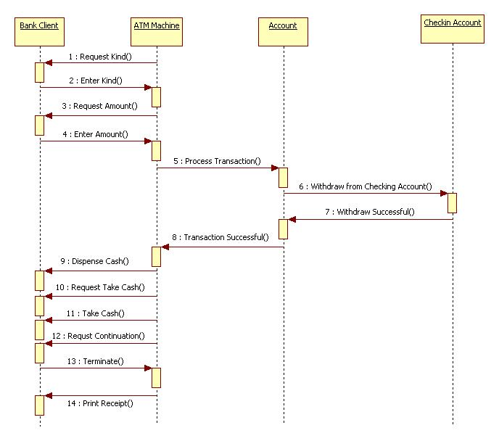
Sequence Diagram in UML

Slide 46
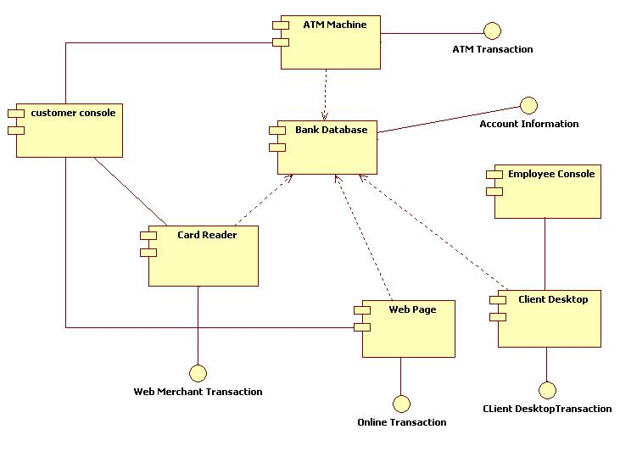
Component Diagram in UML

Slide 47
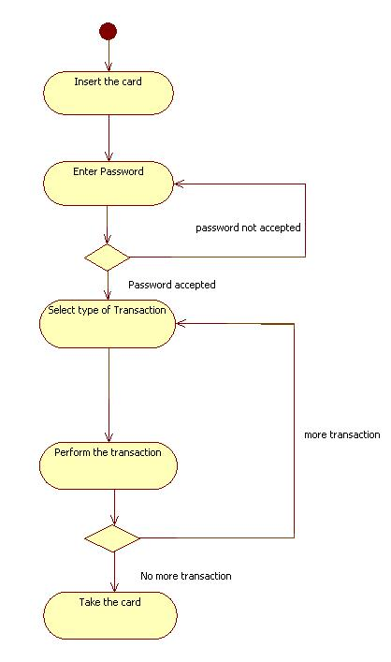
Activity Diagram in UML

Slide 48
Diagrams in UML
7. State-chart Diagram: Shows the different states an object can be in.
Example: The ATM machine can be "Idle" when not in use or "Dispensing Cash" when giving money.
8. Collaboration Diagram: Focuses on how different parts work together during a transaction.
Example: How the user, machine, and bank work together during a withdrawal.
9. Deployment Diagram: Shows where the physical parts are located and connected.
Example: An ATM machine at a local bank connects to a central bank server in another city to process transactions. The diagram shows the ATM and the server as two physical locations that are linked to work together.

Slide 49
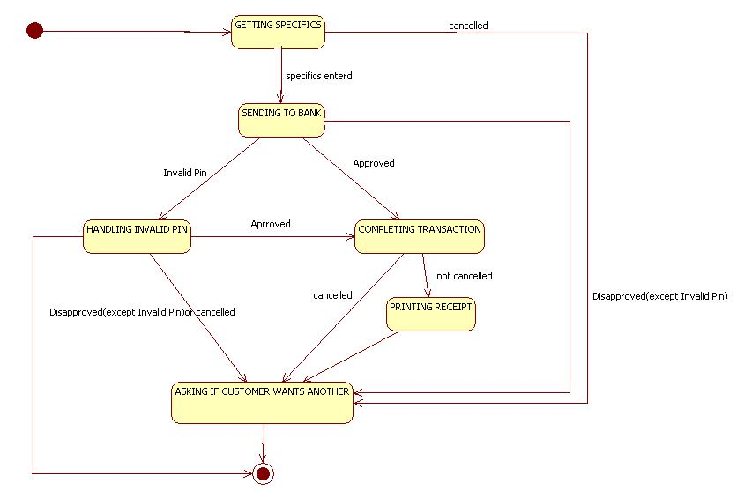
Statechart Diagram in UML

Slide 50
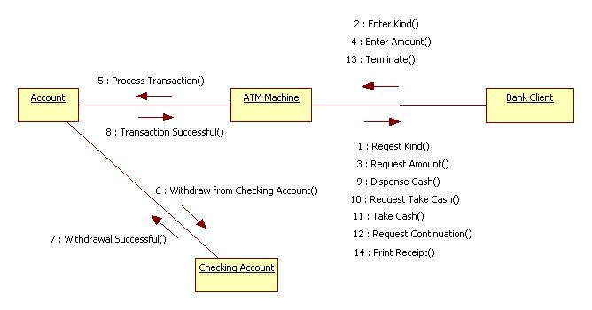
Collaboration Diagram in UML

Slide 51
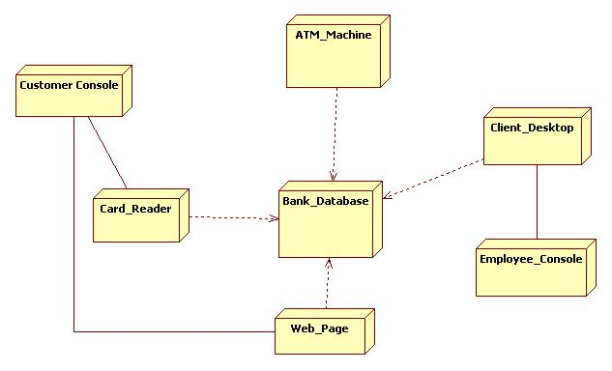
Deployment Diagram in UML

Slide 52
(21CC505PC) SOFTWARE ENGINEERING LAB
UPPAL CAMPUS
NARAYANGUDA
IBRAHIMPATNAM
LAB EXERCISE - 3
CASE TOOL
TOPIC -2
UML DIAGRAMS - USECASE

Slide 53
Usecase Diagram
A Use Case Diagram is a visual representation of how a system interacts with its external users (actors).
It illustrates the system's functional requirements and how the system behaves from a user perspective.

Slide 54
Purpose of a Use Case Diagram
Identifies actors who interact with the system.
Describes interactions (use cases) between the system and its actors.
Shows system boundaries (what is inside or outside of the system).
Useful for understanding the functionality of a system at a high level.

Slide 55

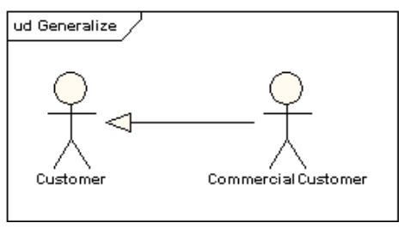
Key Symbols in a Use Case Diagram
Actor: Represents anyone or anything that interacts with the system (usually a human user or external system).
Symbol: Stick figure.
Actors can generalize other actors

Slide 56
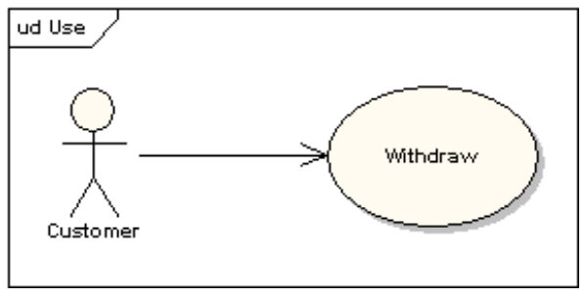
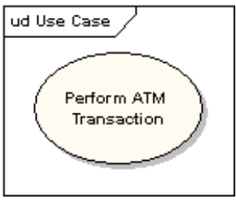
Key Symbols in a Use Case Diagram
Use Case: Describes a specific action or function that the actor performs with the system (like withdrawing money or checking balance).
Symbol: An oval with the name of the use case inside.

Slide 57
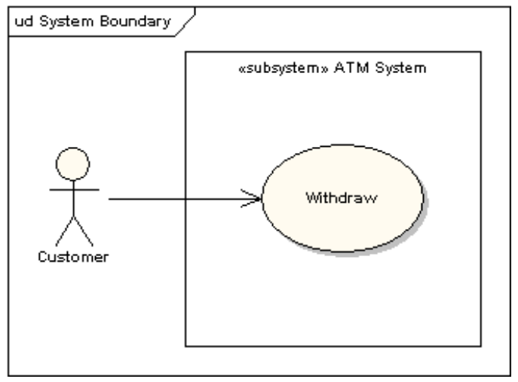
Key Symbols in a Use Case Diagram
System Boundary: Defines the boundary of the system and separates what is inside the system (functions) from the outside (actors).
Symbol: A rectangle enclosing the use cases.

Slide 58
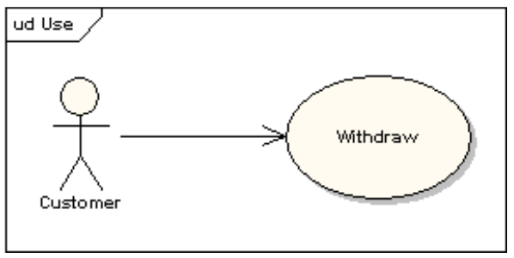
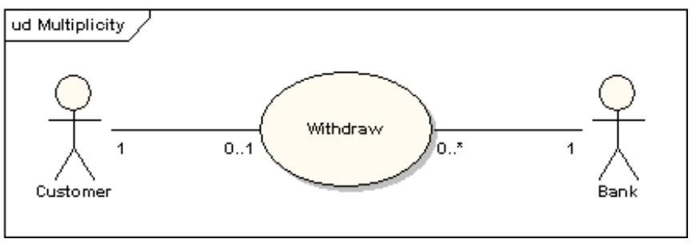
Key Symbols in a Use Case Diagram
Associations (Lines): Represents a relationship between an actor and a use case. It shows that the actor interacts with the use case.
Symbol: A simple line.

Slide 59
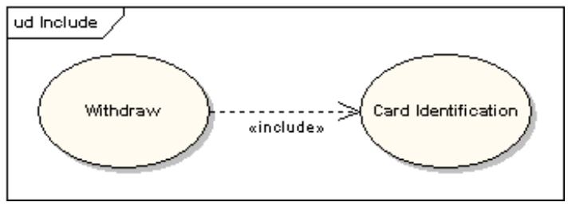
Key Symbols in a Use Case Diagram
Include: Denotes that one use case must always use another use case to complete its task.
Symbol: A dashed arrow labeled <<include>>.
Example: Card identification is always required before withdrawing cash.

Slide 60
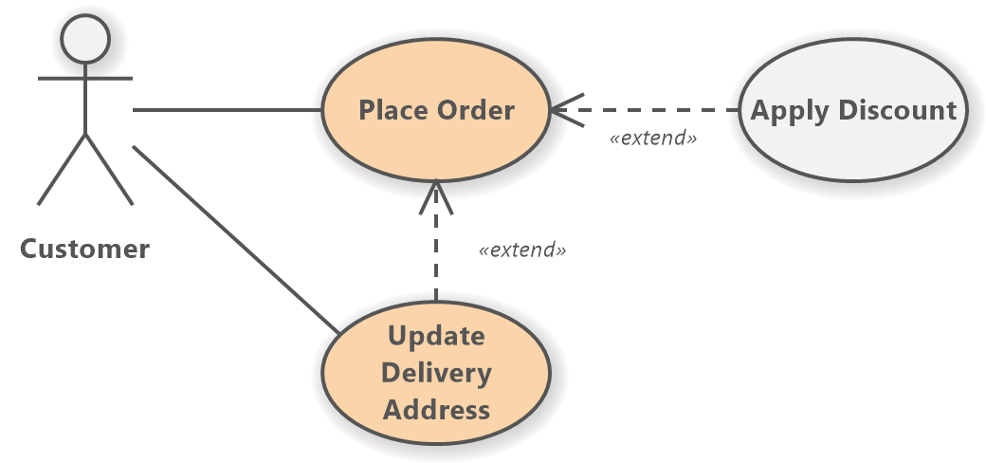
Key Symbols in a Use Case Diagram
Extend: Indicates that one use case can add extra features to another use case, but only if needed or under certain conditions.
Symbol: A dashed arrow labeled <<extend>>.

Slide 61
Steps to Draw a Use Case Diagram for an ATM System
Identify Actors:
Customer: A person who uses the ATM machine to perform tasks like withdrawing money, checking balance, etc.
Bank: Represents the banking system that processes the customer’s requests.

Slide 62
Steps to Draw a Use Case Diagram for an ATM System
Identify Use Cases:
Withdraw Cash
Check Balance
Deposit Cash
Transfer Funds
Change PIN

Slide 63
Steps to Draw a Use Case Diagram for an ATM System
Draw the Diagram:
Start by drawing the system boundary (a rectangle) labeled "ATM System.“
Inside the rectangle, draw ovals representing each use case (Withdraw Cash, Check Balance, etc.).
Place the actors (Customer, Bank) outside the system boundary.
Connect the actors to the relevant use cases using straight lines (associations).

Slide 64
Steps to Draw a Use Case Diagram for an ATM System
Use of Include and Extend:
Include: The "Withdraw Cash" use case might always include "Authenticate User" (since the user must always authenticate before withdrawing money). This means an <<include>> relationship between these use cases.
Extend: The "Check Balance" use case might extend "Withdraw Cash" because, optionally, the user might want to check the balance after withdrawing. This creates an <<extend>> relationship between these use cases.

Slide 65
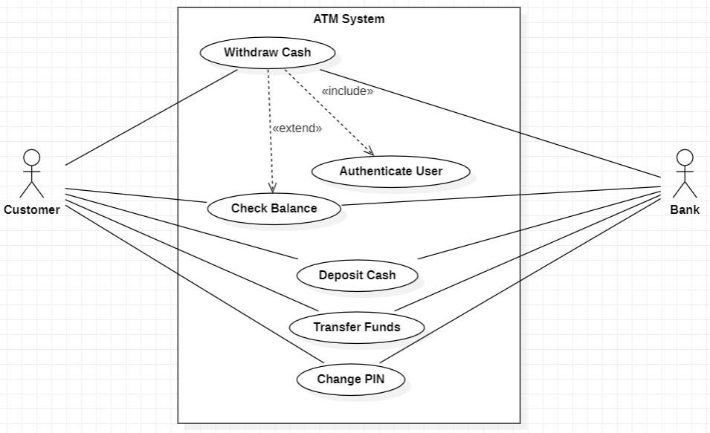
Use Case Diagram for an ATM System

Slide 66
(21CC505PC) SOFTWARE ENGINEERING LAB
UPPAL CAMPUS
NARAYANGUDA
IBRAHIMPATNAM
LAB EXERCISE - 3
CASE TOOL
TOPIC -3
UML DIAGRAMS - CLASS

Slide 67
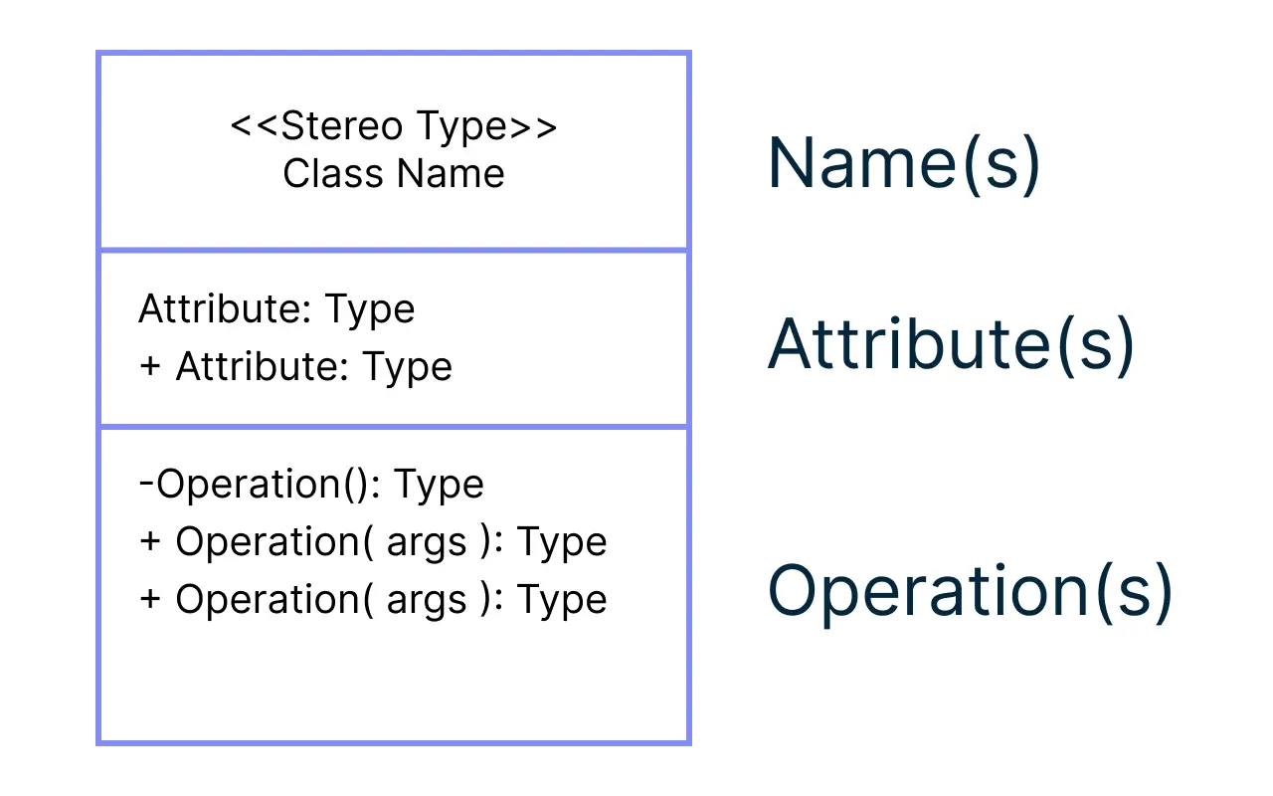
Class Diagram
A class diagram represents the structure of a system by showing its classes, their attributes, operations, and the relationships among objects.

Slide 68
Purpose of a Use Case Diagram
A class diagram shows how parts of a system are connected.
It helps to understand how different things (called classes) work together.
Each class has
Attributes (details like color or size) and
Methods (actions it can do, like drive or stop).
The lines between classes show how they relate to each other.

Slide 69
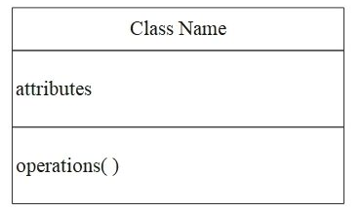
Class Diagram
What is a Class?
A class is like a blueprint for an object (example: Car, Person, Dog).
It has two main parts:
Attributes: Details or characteristics (example: color, name, age).
Methods: Things the class can do (example: drive, walk, bark).

Slide 70
Class Diagram
Attributes:
Attributes are the details about a class.
Example:
For a Car: color, model, speed.
For a Student: name, age, grade.

Slide 71
Class Diagram
Methods:
Methods are actions the class can do.
Example:
For a Car: drive(), stop().
For a Student: study(), enroll().

Slide 72
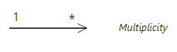
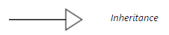
Relationships
Classes can be connected to each other:
Association:
Shows how classes work together (example: Teacher and Student).
Inheritance/Generalization:
One class can inherit details from another (example: Dog inherits from Animal).

Slide 73
Relationships
Inheritance:
Inheritance allows a class to use the properties of another class.
Example:
Animal class (with legs and eyes).
Dog class (inherits from Animal but adds barking).

Slide 74
Relationships
Relationships that can be used are:
Association
Aggregation
Composition
Inheritance (Generalization)
Dependency
Realization

Slide 75
Steps to Draw a Use Case Diagram for an ATM System
Identify the Main Classes:
Think about the main parts of the ATM system. These will be your classes.
Example classes:
ATM (the machine itself)
Customer (the person using the ATM)
Bank Account (the account connected to the ATM)
Withdrawal (action performed by the customer)

Slide 76
Steps to Draw a Use Case Diagram for an ATM System
Define Attributes for Each Class:
List the details or properties each class should have.
Example:
ATM: location, ATM_ID
Customer: name, customerID
BankAccount: accountNumber, balance

Slide 77
Steps to Draw a Use Case Diagram for an ATM System
Define Methods for Each Class:
Identify what each class can do.
Example:
ATM: authenticateUser(), dispenseCash()
Customer: insertCard(), enterPIN()
BankAccount: checkBalance(), withdrawMoney()

Slide 78

Class Diagram for an ATM System

Slide 79
(21CC505PC) SOFTWARE ENGINEERING LAB
UPPAL CAMPUS
NARAYANGUDA
IBRAHIMPATNAM
LAB EXERCISE - 3
CASE TOOL
TOPIC -4
UML DIAGRAMS - SEQUENCE

Slide 80
Sequence Diagram
A sequence diagram shows how objects communicate with each other.
It describes the order of messages between objects.
Useful for understanding the flow of interactions in a system.

Slide 81


Components of Sequence Diagram
Actors: People or external systems interacting with your system.
Objects: Parts of the system that perform actions.

Slide 82


Components of Sequence Diagram
Lifelines: A dotted line under each object showing its existence over time, with an activation box (show when an object is actively performing a task).
Messages: Arrows between objects showing how they communicate.

Slide 83

Sequence Diagram for an ATM System

Slide 84
(21CC505PC) SOFTWARE ENGINEERING LAB
UPPAL CAMPUS
NARAYANGUDA
IBRAHIMPATNAM
LAB EXERCISE - 3
CASE TOOL
TOPIC -5
UML DIAGRAMS - COMPONENT

Slide 85
Component Diagram
A Component Diagram shows how a system is organized into separate, smaller parts called components.
It highlights the structure of the system and the connections between these parts.
It’s useful for understanding how different parts of the system work together.

Slide 86
What are Components?
Components are the individual building blocks of a system.
Each component is like a self-contained unit that performs specific tasks or functions.
Components interact with each other through interfaces (defined connection points).
Example: In a car, the engine, brakes, and transmission are all components that work together to make the car function.

Slide 87
Characteristics of Components
Reusable: Components can often be used in different parts of a system or even in other systems.
Replaceable: If one component fails or needs to be upgraded, it can be replaced without affecting the rest of the system.
Modular: Components are designed to work independently, which makes systems easier to maintain and scale.

Slide 88

Symbols of Component Diagram
Component: It represents a piece of software or a part of a system, like a login system or database.
Symbol: A rectangle with two smaller rectangles (like a tab) sticking out on the left side.

Slide 89

Symbols of Component Diagram
Interface: This shows how a component can interact with other parts, like a button to talk to another system.
Symbol: A small circle (called a "lollipop") connected to a component.

Slide 90

Symbols of Component Diagram
Provided Interface: This means the component is providing a way for others to use its functionality.
Symbol: A lollipop (circle) connected to a component.
Required Interface: This means the component needs something from another part of the system to work.
Symbol: A half-circle (called a socket) connected to a component.

Slide 91


Symbols of Component Diagram
Dependency: It shows that one component depends on another to function properly.
Symbol: A dashed arrow.
Connector: It shows a connection or communication between two components.
Symbol: A solid line with an arrow.

Slide 92
Key Components of an ATM System
ATM Machine (Main Component):This is the physical machine you see and interact with. It includes parts like the screen, buttons, card reader, and cash dispenser.
User Interface (Sub-Component of ATM Machine):This is the screen where you see options like "Withdraw" or "Check Balance" and interact with the machine.
Card Reader (Sub-Component of ATM Machine):This is the slot where you insert your card. It reads the card's information, like your account details.
Cash Dispenser (Sub-Component of ATM Machine):This is the part that gives you money after a successful withdrawal.

Slide 93
Key Components of an ATM System
Bank Database (Main Component):This is the server that holds all your account information, like your balance and transaction history. It confirms whether you have enough money for a withdrawal.
Network (Main Component):This is like the communication line between the ATM machine and the bank database. It sends your withdrawal request from the ATM to the bank’s system and receives confirmation back.

Slide 94

Component Diagram for an ATM System

Slide 95
(21CC505PC) SOFTWARE ENGINEERING LAB
UPPAL CAMPUS
NARAYANGUDA
IBRAHIMPATNAM
LAB EXERCISE - 5
CASE TOOL
TOPIC -1
INSTALLATION OF ECLIPSE, MAVEN, JDK, TOMCAT,CONFIGURING TOMCAT TO ECLIPSE

Slide 96

Install JDK 11 / 17 / 21 versions
Set the class path
Check for the version

Slide 97

Maven installation
Step 1: Check whether maven is present in your system or not
Step 2: Go to Google type download maven and click on download Apache maven

Slide 98

Maven installation
Step 3: Open the Maven Official Webpage

Slide 99

Maven installation
Step 4: Scroll down to go to downloading links

Slide 100

Step 3: click on apache-maven-3.3.9-bin zip

Slide 101

Step 4: extract zip file

Slide 102


Step 5: set environment variables

Slide 103

Edit path

Slide 104


Slide 105

Download the tomcat from the first link as shown

Slide 106

Click on the following link 64-bit windows zip to download the zip file

Slide 107

We can view the downloaded file from Downloads folder as shown

Slide 108

Unzip the downloaded file into the path shown

Slide 109
ECLIPSE UPDATES Installation
Before configuring Tomcat to Eclipse

Slide 110

INSTALL UPDATES into eclipse

Slide 111

Before installing server into eclipse, we need to add Java EE to the eclipse IDE

Slide 112

Click on the drop down menu in Work with and select the following from the list

Slide 113

Check the Web,XML,JAVA EE box to install the latest software into eclipse in order to execute the dynamic web projects, maven web projects. Etc.

Slide 114

Since we develop only Maven web project in DevOps, we can only check the shown two and click on next

Slide 115

Here enable the JST Adapter and JST server adapter

Slide 116

Install them

Slide 117

Click on -> Next

Slide 118

Select on -> I agree

Slide 119

Select on -> I accept -> Finish

Slide 120

Restart the eclipse IDE

Slide 121

After the shown installation, check whether server is available in eclipse as shown

Slide 122

In Show View, we can now see Servers

Slide 123

Click on Apache folder

Slide 124

Browse the Tomcat folder available in your local system as shown

Slide 125

Select Tomcat V 9 as shown

Slide 126

From now on we can start Tomcat server from Eclipse IDE as shown

Slide 127

We can now see that the server is started
Double click on it

Slide 128

The next step is to change the port number of the Tomcat as Jenkins uses 8080, as shown

Slide 129

In server locations make sure second option is selected

Slide 130
Copy the following text in the location shown in the below slides
<role rolename="admin-gui,manager-gui ,manager-script,manager-jmx,manager-status"/>
<user username=“admin" password="1234"roles="manager-gui, admin-gui ,manager-script"/>

Slide 131

Open the tomcat-users.xml file as show, and add the highlighted text in the last

Slide 132

After the changes, click on save

Slide 133

Now restart the server

Slide 134

The server gets restarted as shown

Slide 135

It should show server started

Slide 136

We can see the Tomcat is successfully running on the new port number

Slide 137
(21CC505PC) SOFTWARE ENGINEERING LAB
UPPAL CAMPUS
NARAYANGUDA
IBRAHIMPATNAM
LAB EXERCISE - 5
BUILD TOOLS
TOPIC -2
CREATING MAVEN JAVA PROJECT USING ECLIPSE AND PUSH INTO TO GITHUB

Slide 138


Slide 139

Create a Maven Project - > File - > New -> Maven Project

Slide 140

Click on Next

Slide 141

Select the quickstart archetype under org.apache.maven.archetypes and click on Next

Slide 142

Give Artifact ID of your choice and click Finish, Maven Project is created

Slide 143

In the created project, Check for App.java file containing Hello World program

Slide 144

Right click on your project and Run As Maven Clean - It clears out the existing classes that you compiled from last compile

Slide 145

Check the console for Build Success

Slide 146

Right click on your project and Run As Maven Install - to add artifact(s) to the local repository

Slide 147

Check the console for Build Success

Slide 148

Right click on your project and Run As Maven Install - use to specify test classes or methods we want to execute

Slide 149

Check the console for Build Success

Slide 150

Right click on your project and Run As Maven Install - Compiles source code of the project, Creates JAR or WAR file for the project to convert it into a distributable format.

Slide 151

Specify the goals as – Clean Install Test -> Click on Apply

Slide 152

Click on Run

Slide 153

Check for Build Success in Console

Slide 154

Now Run the Project as Java Application to test the output

Slide 155

Select the Created project from the list - > Click Ok

Slide 156

In the console we can view the output of the project

Slide 157

Next is to push the project into GitHub, for this, create a new repository in GitHub

Slide 158

Select Maven in gitignore- to ignore unwanted target files in maven project while committing

Slide 159

Click on create repository

Slide 160

Copy the HTTPs URL as shown to be copied into Jenkins

Slide 161

Open Git Bash to push the project into GitHub

Slide 162

Clone the GitHub repository into the local system

Slide 163

After cloning follow the steps as shown

Slide 164


One way of cloning the local and global projects is to copy the contents from eclipse workspace to the local cloned repository as shown

Slide 165

The project files are successfully copied into the PresentProject repository

Slide 166

Using Git bash, add and commit the changes made as shown

Slide 167

Push the changes to the GitHub as shown

Slide 168

Refresh the GitHub to see the updated repository

Slide 169

Repository is successfully updated

Slide 170
(21CC505PC) SOFTWARE ENGINEERING LAB
UPPAL CAMPUS
NARAYANGUDA
IBRAHIMPATNAM
LAB EXERCISE - 5
BUILD TOOLS
TOPIC -3
CREATING MAVEN WEB PROJECT USING ECLIPSE AND PUSH INTO TO GITHUB

Slide 172


Slide 173


Slide 174


Slide 175

In pom.xml add the dependencies as shown below.
Maven Web Project in Eclipse

Slide 176

In pom.xml add the dependencies as shown below.
Maven Web Project in Eclipse

Slide 177
In pom.xml add the dependencies as shown below.
Maven Web Project in Eclipse
<dependency>
<groupId>javax.servlet</groupId>
<artifactId>servlet-api</artifactId>
<version>2.5</version>
</dependency>

Slide 178


Slide 179


Slide 180


Slide 181


Slide 182
In the created project, Check for index.jsp file containing Hello World program

Slide 183
Right click on your project and Run As Maven Clean - It clears out the existing classes that you compiled from last compile

Slide 184
Check the console for Build Success

Slide 185
Right click on your project and Run As Maven Install - to add artifact(s) to the local repository

Slide 186
Check the console for Build Success

Slide 187
Right click on your project and Run As Maven Install - use to specify test classes or methods we want to execute

Slide 188
Check the console for Build Success

Slide 189
Right click on your project and Run As Maven Install - Compiles source code of the project, Creates WAR file for the project to convert it into a distributable format.

Slide 190
Specify the goals as – Clean Install Test -> Click on Apply

Slide 191
Click on Run

Slide 192
Check for Build Success in Console

Slide 193


Slide 194


Slide 195


Slide 196


Slide 197


Slide 198


Slide 199


Slide 200


Slide 201


Slide 202


Slide 203


Slide 204


Slide 205


Slide 206


Slide 207


Slide 208


Slide 209


Slide 210
JENKINS Installation
Installation and Configurations

Slide 211

HOW TO DOWNLOAD JENKINS?
Following steps should be followed so that to install Jenkins successfully:
Step 1) Go to https://www.jenkins.io/download/ and select the platform. In our case Windows

Slide 212

Download JENKINS

Slide 213

DOWNLOAD JENKINS

Slide 214

DOWNLOAD JENKINS AS SHOWN

Slide 215

DOWNLOAD JENKINS

Slide 216

Installation of Jenkins

Slide 217

Installation of Jenkins Contd..

Slide 218

Installation of Jenkins Contd..

Slide 219

Installation of Jenkins Contd..

Slide 220

Installation of Jenkins Contd..

Slide 221

Installation of Jenkins Contd..

Slide 222

Installation of Jenkins Contd..

Slide 223

Installation of Jenkins Contd..

Slide 224

Installation of Jenkins Contd..

Slide 225

Installation of Jenkins Contd..

Slide 226

Installation of Jenkins Contd..

Slide 227

Installation of Jenkins Contd..

Slide 228

Go to the path as shown

Slide 229

COPY THE PASSWORD

Slide 230

PASTE AS SHOWN IN THE ADMINISTRATOR PASSWORD BLOCK

Slide 231

Installation of Jenkins PLUGINS

Slide 232

Installation of Jenkins Contd..

Slide 233

Installation of Jenkins Contd..

Slide 234

Installation of Jenkins Contd..

Slide 235

Installation of Jenkins Contd..

Slide 236

JENKINS DASHBOARD

Slide 237

Select ->Manage jenkins
Install plugins in Jenkins Contd..

Slide 238

Click on manage jenkins
Installation of Jenkins Contd..

Slide 239

.
Install plugins in Jenkins Contd..
Check in the available and install the plugins Maven integration plugin, Build pipeline plugin, Pipeline utility, Copy artifacts, Deploy to container ,stage view pipeline plug in. click on -> install without restart

Slide 240

How to config your Jenkins with Maven

Slide 241

Select ->Global tool Configuration

Slide 242

Page of Global Tool Configuration in same page go down for JDK

Slide 243

Here give the JAVA_HOME path

Slide 244

Next give the MAVEN _HOME path

Slide 245

Click -> Apply and Save

Slide 246
(21CC505PC) SOFTWARE ENGINEERING LAB
UPPAL CAMPUS
NARAYANGUDA
IBRAHIMPATNAM
LAB EXERCISE - 6
CONTINUOUS INTEGRATION TOOLS
TOPIC -1
BUILDING THE CI/CD FREESTYLE PIPELINE USING JENKINS FOR MAVEN JAVA PROJECT

Slide 247


Slide 248

Open Jenkins in local host:8080 and create a new item

Slide 249

Create a new Freestyle Project and click ok

Slide 250

The next step is to give the Git repository URL of the project to be built

Slide 251

After adding the repository URL, Specify the Branch as either Master/Main as it is in the GitHub

Slide 252

My project is in main branch so I have mentioned main

Slide 253

Now in Build, Invoke top-level Maven targets

Slide 254

Select the Maven path which is already set in the global credentials in Manage Jenkins

Slide 255

Follow the same goals as done in eclipse starting with clean and install

Slide 256

Now in post build actions-> select Archive the artifacts, to send the output of build project to the testing team

Slide 257

If we want to archive all the artifacts type **/* as shown

Slide 258

Now the next step is to build other projects, where we will create a test project which will be triggered by the build project

Slide 259

Ignore the red warning, as we have not yet created the test project

Slide 260

Create a new freestyle project test as shown and click ok

Slide 261

This time we need not mention the git repository so select None

Slide 262

In Build environment check the box as shown below, this is to discard old builds

Slide 263

To forward the artifacts of the previous project to the current test project, select copy the artifacts from another project in Build as shown

Slide 264

Give the name of the project from which we want to copy the artifacts and check the box ->stable build only->to copy all the artifacts type **/*

Slide 265

Now select Invoke top-level Maven targets in build

Slide 266

This time give the goal as test after selecting the Maven version

Slide 267

In post-build actions->select Archive the artifacts

Slide 268

To save all the artifacts->type **/* and Apply->Save

Slide 269

Create a pipeline by clicking on + symbol in the dashboard ->a pipeline is a collection of events or jobs which are interlinked with one another in a sequence

Slide 270

Give a name to the pipeline->select Build Pipeline View->create

Slide 271

Select the first project to trigger the execution->build project

Slide 272

Apply->Ok

Slide 273

Click on Run -> click on the small black box to open the console to check if the build is success

Slide 274

We can see that the build is success and the test project is also automatically triggered

Slide 275

The pipeline is successful if it is in green color as shown ->check the console of the test project

Slide 276

The test project is successful and all the artifacts are archived successfully

Slide 277
(21CC505PC) SOFTWARE ENGINEERING LAB
UPPAL CAMPUS
NARAYANGUDA
IBRAHIMPATNAM
LAB EXERCISE - 6
CONTINUOUS INTEGRATION TOOLS
TOPIC -2
BUILDING THE CI/CD FREESTYLE PIPELINE USING JENKINS FOR MAVEN WEB PROJECT WITH POLL SCM

Slide 279


Slide 280


Slide 281


Slide 282


Slide 283


Slide 284


Slide 285


Slide 286


Slide 287


Slide 288


Slide 289


Slide 290


Slide 291


Slide 292


Slide 293


Slide 294


Slide 295


Slide 296


Slide 297


Slide 298


Slide 299


Slide 300


Slide 301


Slide 302


Slide 303


Slide 304


Slide 305


Slide 306


Slide 307


Slide 308


Slide 309


Slide 310


Slide 311


Slide 312


Slide 313


Slide 314


Slide 315


Slide 316
(21CC505PC) SOFTWARE ENGINEERING LAB
UPPAL CAMPUS
NARAYANGUDA
IBRAHIMPATNAM
LAB EXERCISE - 6
CONTINUOUS INTEGRATION TOOLS
TOPIC -3
BUILDING THE CI/CD SCRIPTED PIPELINE USING JENKINS FOR MAVEN JAVA PROJECT WITH POLL SCM

Slide 318

Go to Jenkins dashboard → click on new item

Slide 319

Give a name → select 3rd option pipeline → click ok

Slide 320

The pipeline dashboard looks like this → scroll to build triggers -> select build periodically

Slide 321

Click on schedule to know more about how to build periodically "Build Periodically" refers to a feature that allows you to schedule and automate the execution of a build job at regular intervals. It's a way to ensure that certain tasks, such as compiling code, running tests, or deploying software, are performed automatically and on a recurring basis.

Slide 322

The highlighted text helps us to build / trigger every 15 min i.e. for every 15 min it will trigger the build automatically even if there are no changes in the project.

Slide 323

The highlighted text helps us to build / trigger every Min

Slide 324

Scroll down and go to pipeline and paste the script here

Slide 325

Apply and save

Slide 326

Click on build now

Slide 327

The build is successful

Slide 328

I changed my code in GitHub as shown

Slide 329

Commit the changes

Slide 330

Even if we do changes or not, every minute a new build is triggered as shown

Slide 331

This is how it automatically builds → but let's leave it H/15 * * * * (to trigger every 15 min) or H * * 3 * (to trigger every 3 months)

Slide 332



(21CC502PC) SOFTWARE ENGINEERING
UPPAL CAMPUS
NARAYANGUDA
IBRAHIMPATNAM
UNIT - 4
CONTAINERIZATION TOOLS
TOPIC -3
INSTALLATION OF DOCKER, MINIKUBE, ACCOUNT CREATION IN DOCKERHUB

Slide 333
DOCKER INSTALLATION
WITH SYSTEM REQUIREMENTS

Slide 334

Download the docker from the link as shown

Slide 335

Click on the following link to download the executable file

Slide 336

Type winver in Run to check the prerequisites - OS version-Windows 10 pro preferably

Slide 337

Make sure Virtualization is enabled in the system, we can check it in task manager as shown

Slide 338

Click on turn windows features on or off in start

Slide 339

Make sure to check the Virtual Machine Platform and Windows subsystem for Linux checkboxes and click ok

Slide 340

Download Docker for Windows

Slide 341

Double click the executable file and click ok as shown, make sure the following check boxes are selected

Slide 342

The download has started

Slide 343

Click on close and log out

Slide 344

Accept the licence -> click Accept

Slide 345

The local Docker Hub is created

Slide 346

Download WSL2 as shown

Slide 347

Double click the executable file and click next as shown

Slide 348

Installation of WSL2 begins

Slide 349

Once the installation is completed click on Finish

Slide 350

Open Windows Powershell as shown from Start
, Run as administrator

Slide 351

Type the following command, to set WSL as default version

Slide 352

Now we can start the Docker

Slide 353

Click on hub.docker.com and signup as shown

Slide 354

Sign In into Docker Hub

Slide 355

Click on personal-> continue with free

Slide 356

Go to gmail and verify your account

Slide 357

We have successfully logged in into the DockerHub

Slide 358

As of now, there are no containers and Images in Docker Hub

Slide 359

Working with Docker -> First check whether docker installed by command
> docker -v

Slide 360

MINIKUBE INSTALLATION

Slide 361

Search for Minikube install in Google → Open the official Website

Slide 362

Make sure the following options are highlighted and click on latest release to download the executable file

Slide 363

The minikube-installer is downloaded successfully

Slide 364

Select the language preferable English

Slide 365

Click on Next

Slide 366

Agree the licence

Slide 367

Installation is successfully completed, Click on Next

Slide 368

For learning purpose, Minikube version is sufficient, click on Finish

Slide 369

After the installation, we will now get access to cluster, the two commands as displayed

Slide 370

Copy the first command as shown

Slide 371

Open the command prompt and paste the command as shown

Slide 372

Sometimes it gives an error saying, internal command, in that case we need to set the path in environmental variables, firstly copy the minikube path as shown

Slide 373

Open Environmental variables->Doubleclick path in System variables and paste the copied path as shown->click Ok

Slide 374

Restart the command prompt and type the minikube start command again

Slide 375

Check if minikube is successfully running using a command minikube status

Slide 376

If minikube is not in use, make sure to stop the service

Slide 377
RKR21
SOFTWARE ENGINEERING LAB CSE/IT/CSM/CSD III/I
SOFTWARE ENGINEERING LAB
EXERCISE – 7
TOPIC – 1
DOCKER CLI COMMANDS-PART-1
Note: At every step take screenshots and save in a document
Understanding Docker and Redis
What is Docker?
Docker is a tool that makes running applications easy by packaging everything (code, libraries, tools) into containers.
Containers are like lightweight virtual machines but more efficient because they share the host’s system resources.
What is Redis?
Redis (Remote Dictionary Server) is:
A super-fast database that stores data in memory (not on a disk).
Commonly used for:
Caching: Storing temporary data for quick access.
Real-time applications: Like live chat, analytics, or leaderboards.
Data structures: Redis supports lists, hashes, sets, and more.
Example:
Save data: Use the key "name" and the value "Alice".
Retrieve data: Ask Redis for "name", and it will give you "Alice" instantly.

Slide 378
RKR21
SOFTWARE ENGINEERING LAB
CSE/IT/CSM/CSD III/I
Setting Up Docker
Step 1: Choose the Right Terminal
Windows: Use Git Bash or PowerShell (Git Bash is preferred for Docker commands).
Mac/Linux/Ubuntu: Use the built-in Terminal.
Step 2: Verify Docker Installation
Run this command to check if Docker is installed:
docker --version
What It Does:
Displays the installed Docker version to ensure everything is ready.
Docker CLI Commands with hello-world
Why Use hello-world?
The hello-world image is a basic test to ensure Docker is working correctly.
Step 1: Pull the hello-world Image
Command:
docker pull hello-world
What It Does:
Downloads the hello-world image from Docker Hub (Docker’s app store).

Slide 379
RKR21
SOFTWARE ENGINEERING LAB
CSE/IT/CSM/CSD III/I
Where to Run:
Open your terminal (Git Bash for Windows or Terminal for Mac/Linux).
Run the command from any folder.
Step 2: Run the hello-world Image
Command:
docker run hello-world
What It Does:
Creates and runs a container from the hello-world image.
Displays a message to confirm that Docker is installed and working.
Output Example:
Hello from Docker!
This message shows that your installation appears to be working correctly.
Step 3: View All Containers
Command:
docker ps -a
What It Does:
Lists all containers (running and stopped).
The hello-world container will show as "Exited" because it stops after displaying the message.

Slide 380
RKR21 SOFTWARE ENGINEERING LAB
Step 4: Remove the hello-world Container
CSE/IT/CSM/CSD III/I
Command:
docker rm [container-id]
What It Does:
Deletes the container to free up space.
Replace [container-id] with the actual ID from docker ps -a.
Step 5: Remove the hello-world Image
Command:
docker rmi hello-world
What It Does:
Deletes the hello-world image if you no longer need it.
Docker CLI Commands with redis
Why Use redis?
Redis is a powerful, real-world example of a service often run using Docker.
Step 1: Pull the redis Image
Command:
docker pull redis

Slide 381
RKR21
SOFTWARE ENGINEERING LAB
CSE/IT/CSM/CSD III/I
What It Does:
Downloads the official redis image from Docker Hub to your system.
Step 2: Run a Redis Container
Command:
docker run --name my-redis -d redis
What It Does:
Creates and starts a container named my-redis from the redis image.
The -d flag runs the container in the background.
Step 3: Check Running Containers
Command:
docker ps
What It Does:
Lists all running containers.
You should see the Redis container (my-redis) in the list.
Step 4: Access Redis
Command:
docker exec -it my-redis redis-cli or
winpty docker exec -it myredis redis-cli

Slide 382
RKR21
SOFTWARE ENGINEERING LAB
CSE/IT/CSM/CSD III/I
What It Does:
Opens the Redis command-line tool (redis-cli) inside the container.
You can now send commands directly to the Redis server.
winpty: This command makes Git Bash handle the terminal interaction correctly, allowing you to run commands that require user input.
docker exec -it myredis redis-cli: This runs the Redis command-line interface (redis- cli) inside the running myredis container.
Example Redis Commands:
:6379> SET name "Alice" OK
:6379> GET name
"Alice"
Step 5: Stop the Redis Container
Command:
docker stop my-redis
What It Does:
Stops the Redis container but doesn’t delete it.
Step 6: Restart the Redis Container
Command:
docker start my-redis
What It Does:
Restarts the stopped container.
Command:
docker stop my-redis

Slide 383
RKR21 SOFTWARE ENGINEERING LAB
Step 7: Remove the Redis Container
CSE/IT/CSM/CSD III/I
Command:
docker rm my-redis
What It Does:
Deletes the container permanently.
Step 8: Remove the Redis Image
Command:
docker rmi redis
What It Does:
Deletes the Redis image from your local system.

Slide 384
RKR21
SOFTWARE ENGINEERING LAB CSE/IT/CSM/CSD III/I
SOFTWARE ENGINEERING LAB
EXERCISE – 7
TOPIC – 1
DOCKER CLI COMMANDS-PART-2
Note: At every step take screenshots and save in a document
Using a Dockerfile
What is a Dockerfile?
A Dockerfile is a text file with instructions to create a custom Docker image.
Step 1: Set Up Your Folder
Windows:
Create a folder like C:\DockerProjects\Redis.
Open Git Bash and navigate to the folder:
cd /c/DockerProjects/Redis
Mac/Linux:
Create a folder:
mkdir ~/DockerProjects/Redis cd ~/DockerProjects/Redis
Step 2: Write the Dockerfile
Inside the folder, create a file named Dockerfile (no extension).
Add the following content:
FROM redis:latest CMD ["redis-server"]

Slide 385
RKR21
SOFTWARE ENGINEERING LAB
CSE/IT/CSM/CSD III/I
What It Does:
Starts with the official Redis image.
Configures the container to run a Redis server.
FROM redis:latest
Think of "Redis" as a ready-made base (like instant noodles). Instead of making everything from scratch, you're starting with a Redis image (software) that someone else already made.
latest means you're using the newest version of Redis.
CMD ["redis-server"]
This tells Docker to start the Redis program (like clicking "Run" on a software) whenever the container is started.
Docker Commands (Step-by-step):
docker build -t redisnew .
What it does:
This creates (builds) a Docker image using the recipe (Dockerfile) in the current folder (.).
-t redisnew: Gives the image a name/tag ("redisnew"), so you can find it easily.
docker run --name myredisnew -d redisnew
What it does:
Starts a new container (mini computer) from the redisnew image.
--name myredisnew: Names the container "myredisnew" so it’s easy to identify.
-d: Runs the container in the background.
docker ps
What it does:
Shows a list of containers that are running right now.
docker stop myredisnew
What it does:
Stops the container named "myredisnew" (like turning off a computer).
docker login
What it does:
Logs you into your Docker Hub account, so you can upload images.

Slide 386
RKR21 SOFTWARE ENGINEERING LAB CSE/IT/CSM/CSD III/I
docker ps -a
What it does:
Shows a list of all containers, including stopped ones.
docker commit 0e993d2009a1 budarajumadhurika/redis1
What it does:
Takes a snapshot (saves changes) of the container with ID 0e993d2009a1 and creates a new image called budarajumadhurika/redis1.
docker images
What it does:
Lists all images saved on your system.
docker push budarajumadhurika/redis1
What it does:
Uploads the image budarajumadhurika/redis1 to Docker Hub, so others can download it.
docker rm 0e993d2009a1
What it does:
Deletes the container with ID 0e993d2009a1.
docker rmi budarajumadhurika/redis1
What it does:
Deletes the image budarajumadhurika/redis1 from your system.
docker ps -a
What it does:
Shows all containers again to confirm changes.
docker logout
What it does:
Logs you out of Docker Hub.
docker pull budarajumadhurika/redis1
What it does:
Downloads the image budarajumadhurika/redis1 from Docker Hub.
docker run --name myredis -d budarajumadhurika/redis1
What it does:
Starts a new container using the image budarajumadhurika/redis1.
docker exec -it myredis redis-cli

Slide 387
RKR21 SOFTWARE ENGINEERING LAB CSE/IT/CSM/CSD III/I
What it does:
Opens the Redis command-line interface (like a terminal) inside the running container myredis.
SET name "Abcdef"
What it does:
Saves a key-value pair in Redis (key = name, value = Abcdef).
GET name
What it does:
Retrieves the value of the key name from Redis (it will return "Abcdef").
exit
What it does:
Exits the Redis CLI.
docker ps -a
What it does:
Shows all containers again to check their status.
docker stop myredis
What it does:
Stops the container myredis.
docker rm 50a6e4a9c326
What it does:
Deletes the container with ID 50a6e4a9c326.
docker images
What it does:
Lists all images again to confirm which ones remain.
docker rmi budarajumadhurika/redis1
What it does: Deletes the image budarajumadhurika/redis1 again.
Step 4: Remove Login Credentials (Optional)
If you no longer need to be logged in, you can log out:
docker logout
What It Does: Logs you out from Docker Hub and removes your stored credentials.

Slide 388
RKR21
SOFTWARE ENGINEERING LAB CSE/IT/CSM/CSD III/I
SOFTWARE ENGINEERING LAB
EXERCISE – 7
TOPIC – 2
MODIFY AND PUSH DOCKER IMAGE
By following these Commands, you will learn how to:
Create and modify a container (E.g. Ubuntu).
Save the changes to a custom image.
Push the image to Docker Hub.
Pull and reuse the image. This workflow is useful for creating reusable and shareable container environments.
Note: At every step take screenshots and save in a document
Pull the Ubuntu image
docker pull ubuntu
What it does: Downloads the official Ubuntu base image from Docker Hub to your local system. This image is like a minimal operating system ready to run inside a Docker container.
Run a container from the Ubuntu image
docker run -it --name newubuntu -d ubuntu
What it does: Creates and starts a new container from the Ubuntu image.
-it: Allows you to interact with the container (interactive terminal mode).
--name newubuntu: Names the container "newubuntu" for easy identification.

Slide 389
RKR21 SOFTWARE ENGINEERING LAB
-d: Runs the container in the background (detached mode).
CSE/IT/CSM/CSD III/I
List all running containers
docker ps
What it does: Displays a list of all currently running containers, showing details like the container ID, name, image used, and uptime.
Access the running container
docker exec -it 885a01bcdbe0 bash
What it does: Opens a shell (terminal) inside the running container.
exec: Executes a command in a running container.
-it: Allows interactive access.
885a01bcdbe0: The unique container ID of the running container.
bash: Opens the bash shell inside the container.
Check if Git is installed
git --version
What it does: Checks the version of Git installed in the container.
Why it failed: The error bash: git: command not found means Git is not installed in the container.
Update the package list
apt update
What it does: Updates the list of available software packages in the container. It prepares the system for installing new software by fetching the latest versions from online repositories.

Slide 390
RKR21
SOFTWARE ENGINEERING LAB
CSE/IT/CSM/CSD III/I
Install Git
apt install git -y
What it does: Installs Git inside the container.
-y: Automatically confirms the installation (avoids asking for "yes/no").
Verify Git installation
git --version
What it does: Checks if Git is installed correctly and displays its version (e.g., git version 2.43.0).
Exit the container
exit
What it does: Closes the shell session inside the container and returns to your host system.
Stop the running container
docker stop 885a01bcdbe0
What it does: Stops the running container. It doesn’t delete the container, but it halts its operation.
Save the container as an image
docker commit 885a01bcdbe0 budarajumadhurika/newubuntu2024
What it does: Creates a new image from the stopped container with all the changes (like the Git installation).
budarajumadhurika/newubuntu2024: Names the new image with a custom name and tag.

Slide 391
RKR21
SOFTWARE ENGINEERING LAB
CSE/IT/CSM/CSD III/I
List all local images
docker images
What it does: Shows all the Docker images stored on your system, including the newly created image budarajumadhurika/newubuntu2024.
Log in to Docker Hub
docker login
What it does: Logs you into your Docker Hub account so you can upload (push) your image.
It will prompt for your Docker Hub username and password.
Push the image to Docker Hub
docker push budarajumadhurika/newubuntu2024
What it does: Uploads the newly created image to your Docker Hub account so it can be accessed from anywhere.
Log out of Docker Hub
docker logout
What it does: Logs you out of Docker Hub for security.
Remove the container
docker rm 885a01bcdbe0
What it does: Deletes the stopped container permanently from your system.
17. Remove the local image
docker rmi budarajumadhurika/newubuntu2024

Slide 392
RKR21 SOFTWARE ENGINEERING LAB CSE/IT/CSM/CSD III/I
What it does: Deletes the custom image from your local system, freeing up space. (The image is still available on Docker Hub.)
Pull the image from Docker Hub
docker pull budarajumadhurika/newubuntu2024
What it does: Downloads the custom image budarajumadhurika/newubuntu2024 from Docker Hub to your local system.
Run a container from the custom image
docker run --name newubuntu2024 -it budarajumadhurika/newubuntu2024
What it does: Starts a new container from the custom image.
--name newubuntu2024: Assigns a name to the container for easy reference.
-it: Allows interactive access to the container.
Check Git version
git --version
What it does: Verifies that Git is still installed in the new container, confirming that the custom image retains the installed software.
Exit the container
exit
What it does: Closes the shell session inside the container.
List all containers (including stopped ones)
docker ps -a
What it does: Displays all containers on your system, including those that are stopped.

Slide 393
RKR21
SOFTWARE ENGINEERING LAB
CSE/IT/CSM/CSD III/I
Remove the container
docker rm 28aee36085cb
What it does: Deletes the container created from the custom image.
Remove the custom image
docker rmi budarajumadhurika/newubuntu2024
What it does: Deletes the custom image from your local system again.

Slide 394
RKR21
SOFTWARE ENGINEERING LAB CSE/IT/CSM/CSD III/I
SOFTWARE ENGINEERING LAB
EXERCISE – 7
TOPIC – 3
CREATE AND PUSH DOCKER FILE IMAGE
By following these Commands, you will learn how to:
Creating a JavaScript calculator program.
Building and running a Docker container.
Pushing the container image to Docker Hub for sharing.
Pulling and reusing the image on another system.
Note: At every step take screenshots and save in a document
Step 1: Create the JavaScript File
Create a file named calculator.js in your project directory. Add the following code to define simple calculator functions:
// calculator.js function add(a, b) {
return a + b;
}
function subtract(a, b) { return a - b;
}
function multiply(a, b) { return a * b;
}

Slide 395
RKR21 SOFTWARE ENGINEERING LAB CSE/IT/CSM/CSD III/I
function divide(a, b) { if (b === 0) {
return "Cannot divide by zero!";
}
return a / b;
}
// Print the calculated values console.log("Addition (2 + 3):", add(2, 3));
console.log("Subtraction (5 - 2):", subtract(5, 2));
console.log("Multiplication (4 * 3):", multiply(4, 3));
console.log("Division (10 / 2):", divide(10, 2));
Purpose: This script performs basic arithmetic operations and logs the results to the console. Output: When run, this program prints the results of the calculations.
Step 2: Create a Dockerfile
The Dockerfile contains instructions for building the Docker image.
Create a file named Dockerfile (no file extension).
Add the following content:
FROM node:16-alpine
WORKDIR /app
COPY calculator.js /app
CMD ["node", "calculator.js"]
Explanation of the Dockerfile
FROM node:16-alpine
This uses the Alpine version of Node.js 16, which is a minimal, lightweight image.
WORKDIR /app

Slide 396
RKR21 SOFTWARE ENGINEERING LAB CSE/IT/CSM/CSD III/I
Sets the working directory inside the container to /app, where your app files will go.
COPY calculator.js /app
Copies the calculator.js file into the container.
CMD ["node", "calculator.js"]
Tells Docker to run the calculator.js file using Node.js when the container starts.
Step 3: Build the Docker Image
Open a terminal in the directory containing your Dockerfile and calculator.js.
Run the following command:
docker build -t simple-calculator .
docker build: This command builds an image from the Dockerfile.
-t simple-calculator: Tags the image with the name simple-calculator.
.: Refers to the current directory where the Dockerfile is located.
Step 4: Run the Docker Container
Run the container using the image you just created:
docker run simple-calculator
docker run: Starts a new container from the image.
simple-calculator: The name of the image to use.
Expected Output: The console will display the results of the calculations.
Step 6: Push the Image to Docker Hub
Ensure you have a Docker Hub account. Log in using the following command:
docker login
Enter your Docker Hub username and password if prompted

Slide 397
RKR21 SOFTWARE ENGINEERING LAB
Tag the Image for Docker Hub:
CSE/IT/CSM/CSD III/I
Docker images need to be tagged with your Docker Hub username before they can be uploaded:
docker tag simple-calculator your-dockerhub-username/simple- calculator
Replace your-dockerhub-username with your actual Docker Hub username.
Push the Image to Docker Hub:
Push the tagged image to Docker Hub:
docker push your-dockerhub-username/simple-calculator
Once complete, your image will be available in your Docker Hub repository.
Step 7: Pull the Image from Docker Hub
To test the reusability, first, remove the existing image and container: # List all containers (even stopped ones) docker ps -a
# Remove the container by ID docker rm <container-id>
# Remove the local image
docker rmi your-dockerhub-username/simple-calculator
On another machine or after deleting the local image and container, pull the image from Docker Hub:
docker pull your-dockerhub-username/simple-calculator
Step 8: Run the Pulled Image
Run the container from the pulled image:
docker run your-dockerhub-username/simple-calculator

Slide 398
RKR21 SOFTWARE ENGINEERING LAB
You’ll see the same calculation results printed to the console.
CSE/IT/CSM/CSD III/I
#List all the containers
docker ps -a
#Delete the container by its ID docker rm <container-id>
# List all images docker images
# Remove unused images by ID docker rmi <image-id>
# Log out of Docker Hub. docker logout

Slide 399
RKR21
SOFTWARE ENGINEERING LAB CSE/IT/CSM/CSD III/I
SOFTWARE ENGINEERING LAB
EXERCISE – 7
TOPIC – 4
RUNNING MULTIPLE CONTAINERS USING DOCKER COMPOSE
By following the steps in the Docker Compose exercise, you will learn how to:
Set up a WordPress and MySQL multi-container environment using a simple configuration file (docker-compose.yml).
Create and configure Docker services for a web application and a database, including setting environment variables and persistent data storage.
Run multiple containers together with a single command, simplifying deployment.
Access the WordPress application locally through a web browser and link it to the MySQL database for data storage.
Use Docker Compose commands to start, stop, and remove containers easily.
Persist and share data between containers using Docker volumes.
Understand basic networking in Docker Compose to enable communication between containers.
Reuse the setup on any system by copying the docker-compose.yml file and running it.
Note: At every step take screenshots and save in a document
1. What is a docker-compose.yml File?
A docker-compose.yml file is a configuration file that defines: What containers (services) to create.
How they should work together (like connecting WordPress to MySQL). Settings for each container (such as ports, environment variables, etc.).

Slide 400
RKR21 SOFTWARE ENGINEERING LAB CSE/IT/CSM/CSD III/I
This file is written in YAML format, which is a simple, human-readable way to structure data.
2. Where to Find Sample Configurations
You can find examples of docker-compose.yml files:
Docker Documentation: The official Docker website has guides and sample configurations.
GitHub: Many developers share sample files. For example, you can visit Brad Traversy's Docker Example and scroll to version 3 for a beginner-friendly example.
https://gist.github.com/bradtraversy/faa8de544c62eef3f31de406982f1d42
Docker Hub: Each image (like MySQL or WordPress) often includes example configurations.
For simplicity, let’s build a basic docker-compose.yml file for WordPress and MySQL from scratch.
3. Writing a Basic docker-compose.yml File
Step 1: Create a Folder
Go to your desktop or any folder you prefer. Right-click and select New Folder.
Name the folder my_docker_project. Step 2: Open a Text Editor
Open Visual Studio Code, Notepad, or any other text editor.
Create a new file.
Step 3: Write the YAML Configuration
Here’s a simple example of a docker-compose.yml file for WordPress and MySQL:
version: '3.1' services:
db:

Slide 401
RKR21
SOFTWARE ENGINEERING LAB
CSE/IT/CSM/CSD III/I
image: mysql:5.7
container_name: mysql_container environment:
MYSQL_ROOT_PASSWORD: rootpassword MYSQL_DATABASE: wordpress_db MYSQL_USER: wordpress_user MYSQL_PASSWORD: wordpress_pass
volumes:
- db_data:/var/lib/mysql
wordpress:
depends_on:
db
image: wordpress:latest container_name: wordpress_container ports:
- "8000:80"
environment: WORDPRESS_DB_HOST: db:3306
WORDPRESS_DB_USER: wordpress_user WORDPRESS_DB_PASSWORD: wordpress_pass
WORDPRESS_DB_NAME: wordpress_db volumes:
./wordpress_data:/var/www/html
volumes:

Slide 402
RKR21
SOFTWARE ENGINEERING LAB
CSE/IT/CSM/CSD III/I
db_data:
Step-by-Step Explanation
File Format
version: '3.1': This specifies the Docker Compose file version. Version 3 is widely supported.
Services
Under services, we define the containers we want to run:
db (MySQL Container):
image: Specifies the MySQL version (here, 5.7). container_name: Gives the container a name (mysql_container). environment: Sets environment variables for the database: MYSQL_ROOT_PASSWORD: Root user password.
MYSQL_DATABASE: Name of the database WordPress will use.
MYSQL_USER and MYSQL_PASSWORD: Credentials WordPress will use to connect. volumes: Persists database data to the db_data volume.
wordpress (WordPress Container):
depends_on: Ensures the MySQL container starts first. image: Specifies the WordPress version (here, latest).
container_name: Gives the container a name (wordpress_container).
ports: Maps port 8000 on your computer to port 80 in the container. You’ll access WordPress at http://localhost:8000.
environment: Provides settings to connect WordPress to the MySQL database.
volumes: Connects your local directory (./wordpress_data) to the container for file storage.
3. Volumes
volumes help save data even if the container stops. For example:

Slide 403
RKR21 SOFTWARE ENGINEERING LAB
db_data: Stores MySQL database data.
CSE/IT/CSM/CSD III/I
5. Saving the File
Save the file as docker-compose.yml. Place it in the my_docker_project folder.
6. Running the Setup
Step 1: Open Command Line
Open PowerShell or Command Prompt. Navigate to the my_docker_project folder:
cd path_to_my_docker_project Step 2: Start the Containers Run:
docker-compose up -d
This command reads the docker-compose.yml file and creates both the WordPress and MySQL containers.
-d runs the containers in the background.
7. Accessing the Application
Open your web browser.
Go to http://localhost:8000.
Follow the WordPress setup wizard to complete the installation: Site Name.
Admin Username and Password. Email Address.

Slide 404
RKR21
SOFTWARE ENGINEERING LAB
CSE/IT/CSM/CSD III/I
8. Managing Containers
Stop the Containers
To stop the containers without removing them:
docker-compose stop
Start Again
To restart the containers: docker-compose start Remove Containers
To stop and remove everything:
docker-compose down

Slide 405
RKR21
SOFTWARE ENGINEERING LAB CSE/IT/CSM/CSD III/I
SOFTWARE ENGINEERING LAB
EXERCISE – 7
TOPIC – 5
DEPLOYING AND SCALING APPLICATIONS USING MINIKUBE
How to Set Up, Scale, and Stop Nginx Using Kubernetes (Minikube)
What Are We Doing?
In this guide, we will:
Set up a mini-Kubernetes system on your computer using a tool called Minikube. This is like creating a small virtual computer where we can run apps.
Create a Nginx app (Nginx is a simple web server that shows websites).
Make the Nginx app accessible from your browser so you can see it on your screen.
Create more copies of the Nginx app (this helps it handle more users or traffic).
Clean up everything when we're done so nothing is left running.
This process will work the same on Windows, macOS, and Linux, with only a few small differences in how Minikube is set up on each system.
Step 1: Setting Up Minikube and Kubernetes
Start Minikube
Run this command to start the Minikube cluster:
minikube start
Minikube creates a local Kubernetes cluster. This cluster helps us manage and run applications on our machine. Think of it as a small virtual computer running in the background that Kubernetes will use to manage apps.

Slide 406
RKR21 SOFTWARE ENGINEERING LAB
Step 2: Create and manage the Nginx Deployment
CSE/IT/CSM/CSD III/I
Create the Nginx Deployment
Run the following command to create a new deployment (which is like creating an app) for
Nginx:
kubectl create deployment mynginx --image=nginx
Explanation of the command:
kubectl: This is the tool we use to talk to Kubernetes.
create deployment: This tells Kubernetes to create a Deployment, which is a way of managing and running apps.
mynginx: This is the name we give to our app. You can call it anything you want, but we are calling it mynginx.
--image=nginx: This tells Kubernetes to use the nginx image (a ready-made
version of Nginx) to create the app. An image is like a blueprint for creating an app.
You can verify if the Nginx deployment was created correctly by running this command:
kubectl get deployments
You should see mynginx listed as a deployment.
Step 3: Expose the Nginx Deployment to the Outside World
3.1 Expose the Service
We will use the following command to expose the Nginx app to the outside world:
kubectl expose deployment mynginx --type=NodePort --port=80 -- target-port=80
Explanation of the command:
o kubectl expose: This tells Kubernetes to create a Service. A Service is a way to expose your app to the outside world.

Slide 407
SOFTWARE ENGINEERING LAB CSE/IT/CSM/CSD III/I
deployment mynginx: This specifies which app (Deployment) we want to expose.
--type=NodePort: This makes the service accessible outside the Kubernetes cluster by opening a specific port on your computer.
--port=80: This is the port we’ll use to access Nginx from outside the cluster
(port 80 is the default for web servers).
--target-port=80: This is the port inside the pod where Nginx is running (also port 80).
RKR21
Step 4: Scale the Deployment (Make More Copies)
Scale the Deployment
To scale Nginx to 4 replicas (running 4 copies of the app), run the following command:
kubectl scale deployment mynginx --replicas=4
Explanation of the command:
kubectl scale: This tells Kubernetes to increase or decrease the number of
pods running.
--replicas=4: This specifies that we want 4 copies (pods) of the Nginx app running at the same time.
Step 5: Accessing the Nginx App
What is Port Forwarding?
Port forwarding is a way to forward traffic from a port on your computer (like 8081) to a port inside the Kubernetes cluster (like port 80 in the Nginx pod).
We need port forwarding because Jenkins is already using port 8080 on your computer. That’s why we forward traffic from 8081 to port 80 on Nginx.
Run Port Forwarding
Run this command to forward port 8081 on your local machine to port 80 inside the Nginx container:

Slide 408
RKR21 SOFTWARE ENGINEERING LAB
kubectl port-forward svc/mynginx 8081:80
CSE/IT/CSM/CSD III/I
Explanation of the command:
kubectl port-forward: This command forwards traffic from one port to another.
svc/mynginx: This refers to the mynginx service we created earlier.
8081:80: This forwards port 8081 on your local machine to port 80 inside the Nginx container.
Open your browser and go to:
http://localhost:8081
You should see the Nginx welcome page, confirming that the app is running!
Step 6: Alternative Method – Minikube Tunnel
If port forwarding doesn’t work for you, or if you prefer an alternative method, you can use
Minikube Tunnel.
Start Minikube Tunnel
Run this command to create a tunnel that lets you access the service directly:
minikube tunnel
Explanation: This command creates a tunnel between your local machine and the Kubernetes cluster, allowing you to access the service.
Get the Minikube Service URL
Once the tunnel is running, get the URL of the service using:
minikube service mynginx --url
What happens: This command gives you a URL (like http://192.168.x.x:80) that you can open in your browser to access Nginx.

Slide 409
RKR21 SOFTWARE ENGINEERING LAB
6.3 Open the URL in Your Browser
CSE/IT/CSM/CSD III/I
Copy and paste the provided URL into your browser to access Nginx directly.
Step 7: Stopping and Cleaning Up Everything
Stop the Nginx Deployment and Service
To delete the Nginx deployment and service, run:
kubectl delete deployment mynginx kubectl delete service mynginx
Stop Minikube (Optional)
If you’re done with Minikube, stop it to free up system resources:
minikube stop
Delete the Minikube Cluster (Optional) To delete the entire Minikube cluster, run: minikube delete

Slide 410
RKR21
SOFTWARE ENGINEERING LAB CSE/IT/CSM/CSD III/I
SOFTWARE ENGINEERING LAB
EXERCISE – 7
TOPIC – 6
DEPLOYING AND MANAGING MONITORING SYSTEMS USING NAGIOS IN DOCKER
In this exercise, we will be:
Setting up and running Nagios using Docker for quick and simple installation.
Accessing the Nagios Dashboard to explore its features.
Monitoring the health and status of systems and services effectively.
Learning how to manage checks, notifications, and downtime settings.
Understanding how to stop and remove the Nagios Docker container when finished.
Note: At every step take screenshots and save in a document
Step 1: Pulling the Nagios Image
Command to Pull Nagios
Open a terminal and type this command to download the Nagios image:
docker pull jasonrivers/nagios:latest
This command tells Docker to download the latest version of Nagios from a specific repository (jasonrivers).
Step 2: Running Nagios
1. Command to Run Nagios
docker run --name nagiosdemo -p 8888:80 jasonrivers/nagios:latest
Explanation of Each Part:

Slide 411

RKR21
SOFTWARE ENGINEERING LAB CSE/IT/CSM/CSD III/I
--name nagiosdemo: Names the container nagiosdemo so you can easily identify it later.
-p 8888:80: Maps your computer’s port 8888 to the container’s port 80
(port 80 is used for web access).
jasonrivers/nagios:latest: Specifies the software image (Nagios) and its version.
Step 3: Accessing Nagios
Open a browser and type:
localhost:8888
This will open the Nagios web interface.
Login Credentials:
Username: nagiosadmin
Password: nagios
Understanding the Nagios Dashboard
1. General Information

Slide 412
RKR21 SOFTWARE ENGINEERING LAB CSE/IT/CSM/CSD III/I
Nagios Version: The top-left corner shows the version of Nagios you’re using (e.g., Version 4.5.7).
Navigation Panel (Left-Side Menu)
Home: Returns you to the main dashboard.
Hosts: Displays the list of systems (hosts) being monitored.
Services: Shows activities or tasks being monitored, such as CPU usage, disk space, or network status.
Reports: Provides historical data and trends about your systems.
Dashboard Content
System Status (Top Section)
Green Boxes: Indicate periods when everything was working fine.
Red or Yellow Boxes: Indicate problems or warnings.
Latest Alerts
Source: Shows which system (e.g., IP address) had the issue.
Alert: Describes the problem (e.g., "Memory usage critical").
Server Statistics
Load: How much work the server is handling.
CPU Stats: How busy the processor is.
Status Grid
Green Circles: Everything is working fine.
Red or Yellow Circles: Indicate issues.
Monitoring Specific Hosts and Services
Monitor Hosts:
Go to the Hosts menu on the left.
You’ll see a list of systems being monitored.

Slide 413

RKR21
SOFTWARE ENGINEERING LAB CSE/IT/CSM/CSD III/I
Monitor Services:
Click on a host to see details about the services being monitored, such as CPU usage or memory status.
Step 4: Exploring the Host Information Page
Top Section (Basic Host Details)
Host: The system being monitored is named localhost (your own computer).
Member of: This host belongs to the linux-servers group.
IP Address: The host’s IP address is 127.0.0.1 (this means it’s your local system).
Middle Section (Host State Information)
This section shows the current health and performance of the host:
Host Status: UP (green color) means the system is working fine.
Status Information: Nagios checks if the system is alive using a "ping" command.
No Packet Loss: The system is responding properly.

Slide 414
RKR21 SOFTWARE ENGINEERING LAB CSE/IT/CSM/CSD III/I
Round-Trip Time (RTA): The time it takes for a message to go to the system and back is very fast.
Last Check Time: The last time Nagios checked the system.
Next Check: When the next check will happen.
Flapping: Flapping occurs when a system repeatedly goes up and down. Here, it’s stable (NO).
Active Checks: Monitoring features like active checks and notifications are all
ENABLED (green boxes).
c. Right Section (Host Commands)
You can perform actions for this host using these commands:
Locate Host on Map: See the host’s location on the network map.
Disable Active Checks: Stop Nagios from checking this host automatically.
Re-schedule Next Check: Force Nagios to check the host immediately.
Disable Notifications: Turn off alerts for this host.
Schedule Downtime: If you plan to shut down the host, use this to avoid unnecessary alerts.
Stopping Nagios
To stop Nagios, we need to stop the Docker container running it.
Find the Container Name: If you used the earlier command to start Nagios, the container name is nagiosdemo. If you’re unsure about the name, follow these steps:
Open your terminal.
Type this command to see all running containers:
docker ps
You’ll see a list of containers. Look for the CONTAINER NAME column to find the container running Nagios (e.g., nagiosdemo).
Stop the Container: Use the following command to stop the Nagios container:
docker stop nagiosdemo

Slide 415
RKR21
SOFTWARE ENGINEERING LAB CSE/IT/CSM/CSD III/I
nagiosdemo: This is the name of the container. Replace it with the actual container name if it’s different.
Step 2: Deleting the Nagios Container
If you no longer need Nagios, you can delete the container.
Remove the Container: Use this command to delete the container:
docker rm nagiosdemo
This permanently deletes the Nagios container.
If the container is still running, you’ll see an error. In that case, ensure you’ve stopped it first (Step 1).
Step 3: Deleting the Nagios Image
Find the Image Name: To see all Docker images on your system, type:
docker images
Look for the IMAGE NAME column. You should see something like
jasonrivers/nagios.
Delete the Image: Use this command to remove the image:
docker rmi jasonrivers/nagios:latest
If the image is still being used by a container, you’ll get an error. Make sure you’ve already deleted the container (Step 2).

Slide 416
RKR21
SOFTWARE ENGINEERING LAB CSE/IT/CSM/CSD III/I
SOFTWARE ENGINEERING LAB
EXERCISE – 8
TOPIC – 1
AWS ACADEMY LEARNING ACCOUNT CREATION
In this exercise, we will be:
Set up an AWS Academy account to access cloud services for learning purposes.
Navigate the AWS Academy Learner Lab to activate and explore its features.
Create a free AWS account by completing email, billing, and phone verification steps.
Access the AWS Management Console to explore services like EC2 for cloud-based tasks.
Learn to start, manage, and terminate AWS lab sessions while adhering to usage limits.
Note: At every step take screenshots and save in a document
AWS Academy Account Creation
Check Your Email
Look for an AWS Academy course invitation email.
Click on Get Started.
Create Your Account
Click Create My Account.
Set up a password.
Choose an Indian time zone (e.g., IST).
Check all the provided boxes.
Scroll down and click Register.
Access the Account
After account creation, click on Account in the window.
Logout and Relogin Instructions
To log out: Click Logout.

Slide 417
RKR21
SOFTWARE ENGINEERING LAB CSE/IT/CSM/CSD III/I
To log back in:
Go to Google and search for AWS Academy Login.
From the search results, look for Untitled and click on it.
Select Student Login.
Enter your username and password, then click Login.
Navigating the AWS Academy Learner Lab
After logging in, click on AWS Academy Learner Lab.
Click on Modules and scroll down.
Select AWS Academy Learner Lab.
Agree to Terms & Conditions
Read through the terms and conditions provided.
Scroll down and click on I Agree.
Start the Sandbox Environment
If there’s a red dot beside AWS, it indicates that the lab environment is in a stopped state.
Click Start Lab to activate the environment.
Lab Environment Details
Once the lab starts, you can use it for 4 hours.
If additional time is needed, restart the lab to reset the timer.
You are provided with $50 in free credits:
Important: Exceeding this limit will block further AWS access using the same email ID.
Once AWS status turns green, click on it to access the AWS dashboard.
Perform Exercises
From the AWS dashboard, click on EC2 (visible under the Recently Visited
section).
Begin your lab exercises from this point.
Ending the Lab
After finishing your tasks, click End Lab.
Confirm by clicking Yes.
A red dot beside AWS indicates the lab environment has stopped.

Slide 418
RKR21
SOFTWARE ENGINEERING LAB
CSE/IT/CSM/CSD III/I
The below is for your information, no need to take screenshots from here
Steps to Create a Free Tier AWS Account
Visit the AWS Website
Open aws.amazon.com.
Click Create AWS Account.
Provide Account Details
Enter your email ID and name.
A verification code will be sent to your email.
Enter the verification code on the website.
Set Up Password
Create and confirm a password for your account.
Provide Contact Details
Enter your contact information and agree to the Terms and Conditions.
Click Create Account.
Billing Details
Add your billing information for account verification.
AWS will temporarily charge ₹2 for verification purposes, which will be refunded once verification is complete.
Phone Verification
After billing verification, enter your working contact number.
Choose your country and click Send SMS.
Enter the verification code sent to your phone.
Select a Plan
Choose the Basic Plan (free).
Click Complete Sign-Up.
Access the AWS Management Console
After completing the sign-up, navigate to the AWS Management Console.
Select your role as Academic/Researcher and your interest as DevOps.
Click Submit.

Slide 419
RKR21 SOFTWARE ENGINEERING LAB
Using the AWS Management Console
CSE/IT/CSM/CSD III/I
Sign into the AWS console using your Root User credentials.
The console dashboard will appear, where you can access and explore various AWS services.

Slide 420
RKR21
SOFTWARE ENGINEERING LAB CSE/IT/CSM/CSD III/I
SOFTWARE ENGINEERING LAB
EXERCISE – 8
TOPIC – 2
PROJECT DEPLOYMENT IN THE AWS CLOUD USING EC2 INSTANCE
In this exercise, we will be:
Launch a virtual server (EC2 instance) on AWS.
Install essential tools like Docker, Git, and Nano.
Create and deploy a simple web application using Docker.
Access the application online.
Clean up resources to avoid unnecessary charges.
Note: At every step take screenshots and save in a document
Step 1: Log in to AWS and Go to EC2
In this step, we will log in to our AWS account and access the EC2 service.
Log in to your AWS account.
On the AWS homepage, click Services, then choose EC2 under Compute.
Step 2: Launch an EC2 Instance
Here, we will set up a virtual server to host our web application.
Click Launch Instance.
Configure the settings as follows:
Name: Enter a name like "MyWebServer" to identify your server.
Application and OS: Choose Ubuntu (Free Tier Eligible).
1

Slide 421
RKR21
SOFTWARE ENGINEERING LAB CSE/IT/CSM/CSD III/I
Instance Type: Select t2.micro (1 CPU, 1 GB RAM).
Key Pair: Create a new key pair, download the .pem file, and save it securely.
Network: Enable Allow HTTP/HTTPS traffic to make your accessible.
Storage: Use the default 8 GB.
3. Click Launch Instance and wait until the status changes to "Running."
website
Step 3: Connect to the EC2 Instance
In this step, we will connect to our virtual server.
Select your instance, click Connect, and copy the SSH command.
Open PowerShell (Windows) or Terminal (Mac/Linux) on your computer.
Navigate to the folder where your .pem file is saved using the cd command.
Paste the SSH command and press Enter. Type "yes" if prompted.
Step 4: Prepare the Instance
Now, we will prepare the server by installing required tools.
Update the system to ensure all software is up to date:
sudo apt update
Install Docker to package and run our web application:
sudo apt-get install docker.io
Install Git to manage and download code:
sudo apt install git
Install Nano for editing files directly on the server:
sudo apt install nano
2

Slide 422
RKR21 SOFTWARE ENGINEERING LAB
Step 5: Create Your Web Application
CSE/IT/CSM/CSD III/I
In this step, we will build a simple web page and upload it to GitHub.
On your computer, create a file named index.html and add the following content:
<html>
<head><title>My Webpage</title></head>
<body><h1>Hello from AWS!</h1></body>
</html>
Initialize Git in the file's folder:
git init git add .
git commit -m "First commit"
Create a GitHub repository, copy its HTTPS URL, and upload your file:
git remote add origin <Your_Repo_URL> git push -u origin main
Step 6: Deploy the Web Application Using Docker
Here, we will deploy the web application to the EC2 instance.
On the EC2 instance, clone your GitHub repository:
git clone <Your_Repo_URL>
Create a Dockerfile in the project folder using Nano:
nano Dockerfile
Add the following content:
FROM nginx:alpine
COPY . /usr/share/nginx/html

Slide 423
RKR21
SOFTWARE ENGINEERING LAB CSE/IT/CSM/CSD III/I
Save the file by pressing Ctrl + O, then Enter, and exit Nano with Ctrl + X.
3. Build and run the Docker container to serve the web application:
sudo docker build -t my-web-app . sudo docker run -d -p 80:80 my-web-app
Step 7: Access Your Web Application
In this step, we will view the deployed web page online.
Copy the Public IP Address of your EC2 instance from the AWS console.
Paste it into your browser (e.g., http://<Public_IP>).
You’ll see your web page with the message "Hello from AWS!" displayed.
Step 8: Clean Up
Finally, we will clean up resources to avoid any charges.
Stop the running Docker container:
sudo docker ps
sudo docker stop <Container_ID>
Terminate the EC2 instance in the AWS console by selecting it, clicking Instance State, and choosing Terminate Instance.

Slide 424
RKR21
SOFTWARE ENGINEERING LAB CSE/IT/CSM/CSD III/I
SOFTWARE ENGINEERING LAB
EXERCISE – 8
TOPIC – 3
MAVEN WEB PROJECT DEPLOYMENT IN THE AWS CLOUD USING EC2 INSTANCE
In this exercise, we will be:
Launch an EC2 instance on AWS.
Install Docker, Git, and Nano.
Deploy a Maven web project using Docker and expose it on port 9090.
Access the application online.
Clean up resources to avoid unnecessary charges.
Note:
At every step take screenshots and save in a document.
This guide uses JDK 11, which was used for developing the project. If your project was developed with JDK 21, adjust the Dockerfile as instructed in Step 5.
Step 1: Launch an EC2 Instance
In this step, we will set up a virtual server to host our Maven web project.
Log in to AWS: Access your AWS account and navigate to Services > Compute > EC2.
Launch the instance:
Name: Enter a descriptive name, e.g., MavenWebProjectServer.
AMI: Select Ubuntu Server (Free Tier Eligible).
Instance Type: Choose t2.micro.
Key Pair: Create a key pair or use an existing one. Save the .pem file securely.
Network Settings: Enable Allow HTTP/HTTPS traffic.

Slide 425
RKR21 SOFTWARE ENGINEERING LAB CSE/IT/CSM/CSD III/I
Storage: Use the default size (8 GB).
Click Launch Instance and wait for the status to change to "Running."
Note down the Public IP Address from the EC2 dashboard.
Step 2: Connect to the EC2 Instance
In this step, we will connect to the server.
Open PowerShell (Windows) or Terminal (Mac/Linux) and navigate to the folder with the .pem file using the cd command.
Use SSH to connect to the instance:
ssh -i "<KeyFile>.pem" ubuntu@<Public_IP>
Replace <KeyFile> with the .pem file name and <Public_IP> with your instance’s public IP.
If prompted, type "yes" to confirm the connection.
Step 3: Prepare the EC2 Server
Now, we will install the necessary tools.
Update the system:
sudo apt update
Install Docker:
sudo apt-get install docker.io -y
Install Git:
sudo apt install git -y
Install Nano (text editor):
sudo apt install nano -y

Slide 426
RKR21 SOFTWARE ENGINEERING LAB
Step 4: Clone Your Maven Web Project
CSE/IT/CSM/CSD III/I
In this step, we will download the Maven project from GitHub.
Go to your GitHub repository, click Code > HTTPS, and copy the URL.
Clone the repository:
git clone <Your_Repo_URL>
Replace <Your_Repo_URL> with the copied URL.
Step 5: Create a Dockerfile
We will create a Dockerfile to containerize the Maven project.
Navigate to the project folder:
cd <Your_Project_Folder>
Replace <Your_Project_Folder> with the folder name.
Open Nano to create the Dockerfile:
nano Dockerfile
Add the following content based on the JDK version used during development:
For JDK 11 (used in this guide):
FROM tomcat:9-jdk11
COPY target/*.war /usr/local/tomcat/webapps/
For JDK 21:
FROM tomcat:9-jdk21
COPY target/*.war /usr/local/tomcat/webapps/
Save and exit Nano: Press Ctrl + O, then Enter, and Ctrl + X.

Slide 427
Explanation:
FROM tomcat:9-jdk11 or FROM tomcat:9-jdk21 specifies the Tomcat base image with the appropriate JDK version.
COPY target/*.war /usr/local/tomcat/webapps/ copies the .war file into the webapps directory of Tomcat for deployment.
Step 6: Build and Run the Docker Container
Build the Docker image:
sudo docker build -t maven-web-project .
Run the container:
sudo docker run -d -p 9090:8080 maven-web-project
-d: Runs the container in the background.
-p 9090:8080: Maps port 9090 on your instance to port 8080 in the container.
Step 7: Configure Security Group for Port 9090
We will ensure the EC2 instance allows traffic on port 9090.
In the AWS EC2 dashboard, go to Security and click the Security Group ID.
Add an inbound rule:
Type: Custom TCP
Port Range: 9090
Source: Anywhere (0.0.0.0/0) or your IP.
Save the changes.
Step 8: Access the Web Application
We will now test the deployment.
Open a browser and navigate to:
RKR21
SOFTWARE ENGINEERING LAB
CSE/IT/CSM/CSD III/I

Slide 428
RKR21
SOFTWARE ENGINEERING LAB
CSE/IT/CSM/CSD III/I
http://<Public_IP>:9090/<Your_Project_Name>
Replace <Public_IP> with the instance’s public IP and <Your_Project_Name>
with your Maven project name.
Step 9: Clean Up
Finally, we will stop the container and terminate the instance.
Stop the Docker container:
sudo docker ps
sudo docker stop <Container_ID>
Replace <Container_ID> with the container ID.
Terminate the EC2 instance In the EC2 dashboard, go to Instance State and select
Terminate Instance.

